Slide 1
Python
James R. Bradley

Slide 2
This Course
Same format as other boot camps
Competency test due Sunday 11:59 p.m.
Start on the exam any time
Course LMS
blackboard.wm.edu
Posted daily
Class videos
Homework solutions and discussion problems

Slide 3
Reference Book
Python for Everybody: Exploring Data in Python 3, by Charles Severance
amazon.com: $9.99
Free electronic version
http://do1.dr-chuck.com/pythonlearn/EN_us/pythonlearn.pdf
I’ll reference relevant chapters
We’ll also cover material not in this book
Courier font indicates programming statements

Slide 4
Computer Programming
What is a computer program?
Notes:
What types of computer programming statements are used?
Math operations
Data input and output from files, Internet, etc.
Conditional statements: sometimes you need to execute a statement and sometime you don’t
Loops: for repetitive processing of statements
Operations on string data (text): searching, qualifying, concatenation, and extraction
Data conversion

Slide 5
Why Program… in Python?
Python is a popular language in data analytics
Data is most often:
Too large to inspect visually
Too large/slow to analyze with Excel, Minitab, …
Difficult to acquire and cleanse manually
Python can integrate the operation of many software packages…
MySQL, Gurobi (optimization), Tableau
Notes:
Also… Python is the most popular introductory programming language and it is often used in analytics

Slide 6
Essential Programming Concepts
Sequential execution
Programming environments
Python data types
Conditional execution
Repeated execution
Input
Output
Functions
Data management and computation

Slide 7
References
Textbook
Severance, Chapter 1

Slide 8
Table of Contents
Python (Anaconda) Installation
Get Course Material
Jupyter set-up
Introduction to Python
Variables, Data Types, & Statements
Keyboard Input
Boolean & Conditional Statements
Commenting and Markdown
Functions
Spyder Development Environment
Debugging

Slide 9
Table of Contents
Lists
More Sorting
Sets
Loops
List Comprehension
Tuples
Dictionaries
Files Input & Output
numpy package
pandas package
Additional Material
Regular Expressions

Slide 10
Python (Anaconda) Installation & Course Material Set-up

Slide 11
How to Create Programs
We need a program in which we write our Python programs: development environments
Jupyter
Spyder
PyCharm
Atom
Visual Studio
IDLE
Development environments also execute the code we write and help us to debug it

Slide 12
How to Create Programs
Programming language:
Python
Development environments
Jupyter
Spyder
Anaconda
Provides Jupyter and Spyder
Links Jupyter and Spyder with Python execution

Slide 13
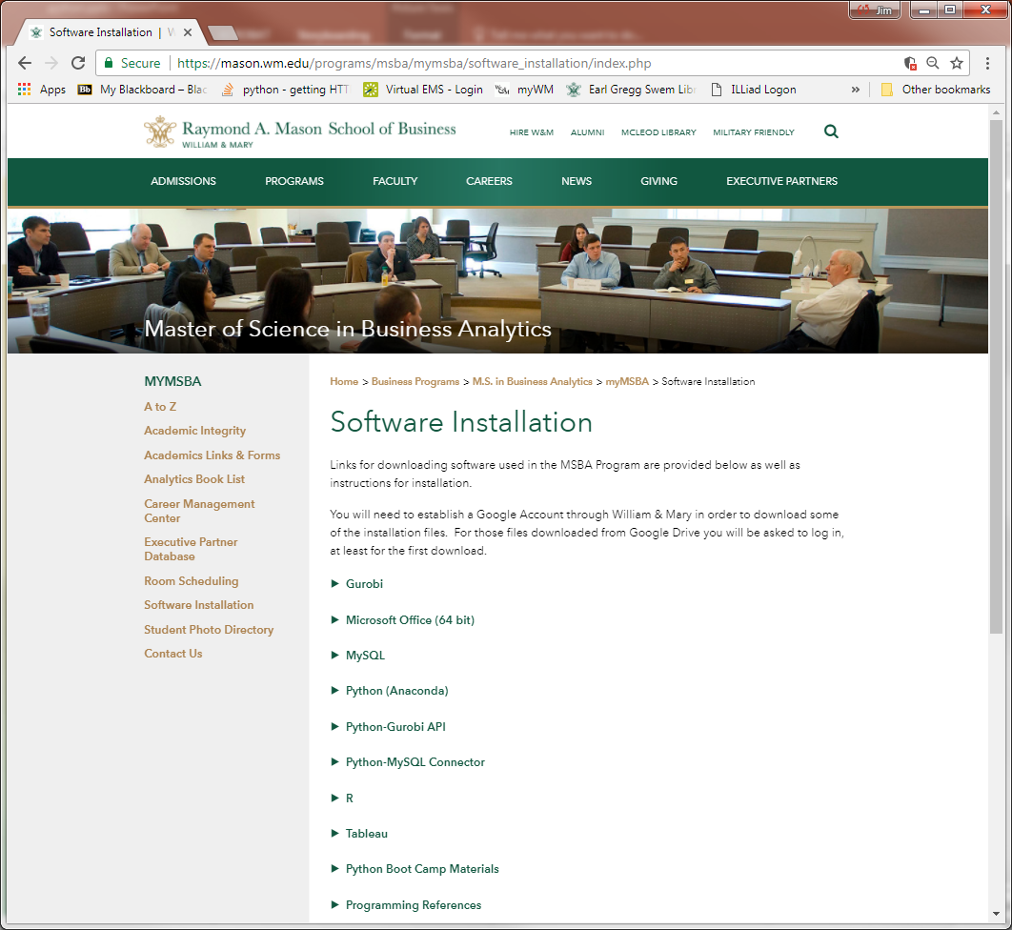
Python (Anaconda) Installation
MSBA software
mason.wm.edu/current/mymsba/software_installation/index.php
Click on the arrow

Slide 14
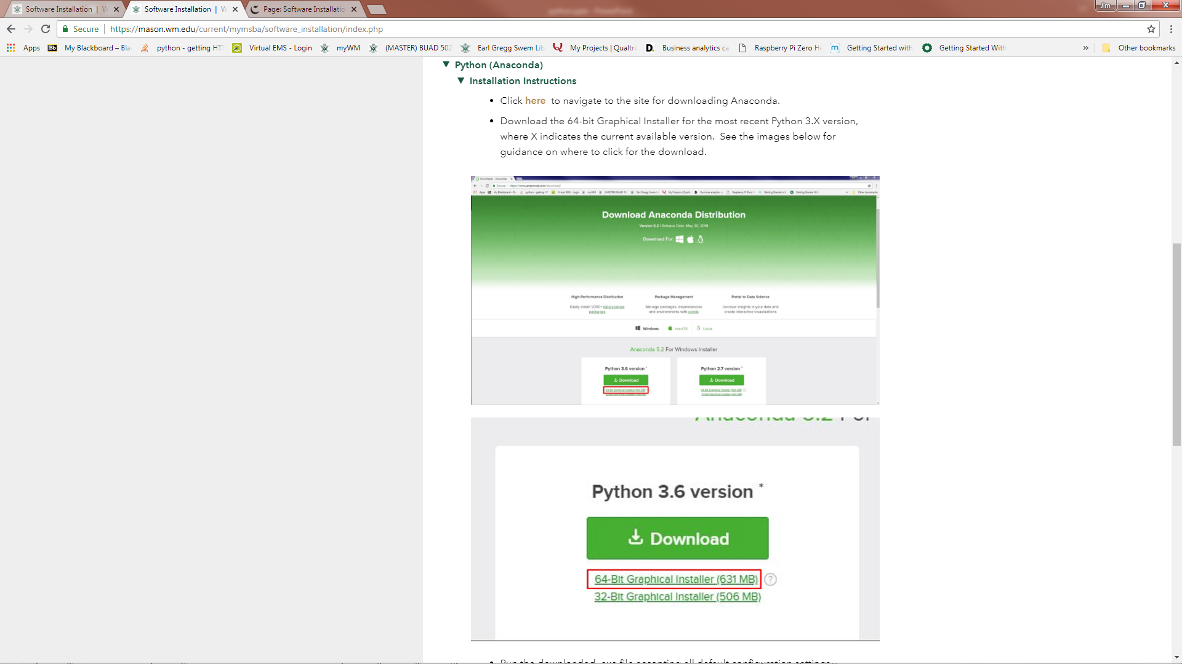
Python (Anaconda) Installation
Follow installation instructions

Slide 15
Anaconda
Why Anaconda Python?
Two Python coding environments
Spyder
Script Editor and Console Window for immediate results
Efficient debugging
Breakpoints
Ideal for execution of “final” algorithms
Jupyter Notebook
More on next slide
Many packages already included in Anaconda
A package is code giving Python more functionality
Augmenting base Python code with others’ contributions

Slide 16
Python Versions
Python 2.7 versus Python 3.X
Different syntax
Most people still use 2.7 although 3.X is becoming the standard and is actively being improved
2.7 will be used by fewer and fewer people
We’ll use Python 3.X since it is the best version and becoming more frequently used

Slide 17
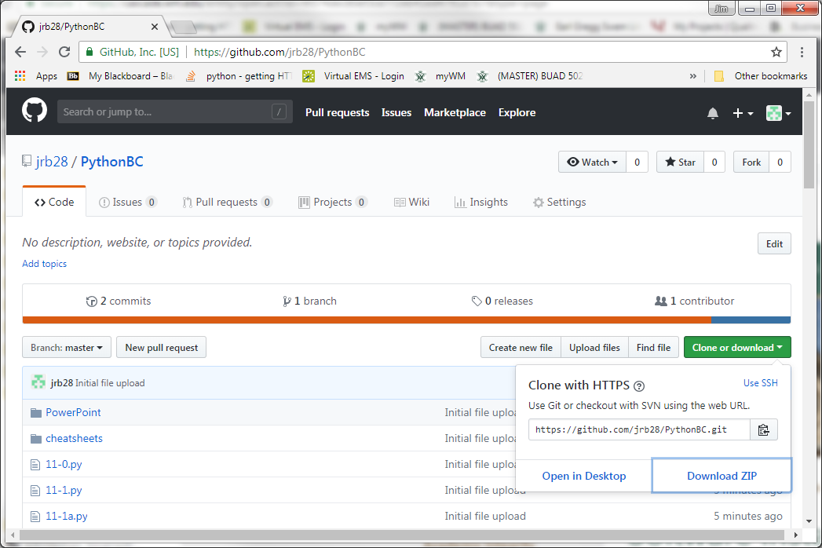
Course Material Set-Up
1
2

Slide 18
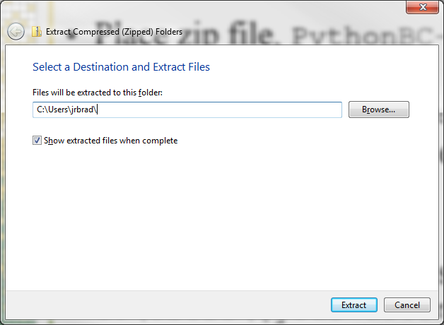
Course Material Set-Up
Use Extract All to extract the files to this location:
C:\Users\[your username]\
Change this folder name:
C:\Users\[your username]\PythonBC-master
To this:
C:\Users\[your username]\PythonBC

Slide 19
Course Material Set-Up
Course code and data files:
C:\Users\[your_username]\PythonBC
Cheatsheets
C:\Users\[your_username]\PythonBC\cheatsheets
From: http://www.datasciencefree.com/cheatsheets.html
This PowerPoint
C:\Users\[your_username]\PythonBC\PowerPoint

Slide 20
Blackboard Course Site
https://blackboard.wm.edu
Course name:
BUAD 502C Python Programming (CRN 31789)
Content
Session video recordings
End-of-week competency exam
Submission of competency exam
Link to github course materials

Slide 21
Jupyter Notebook Set-up
What is Jupyter?
Multiple coding cells
Execute Python code, cell by cell
Good environment for
“Prototyping” code
Exploring data
Communicating analysis sequence, including graphs
Not good for running a large program

Slide 22
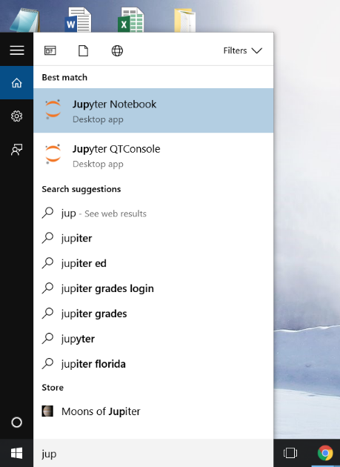
Jupyter Development Environment
Windows 10

Slide 23
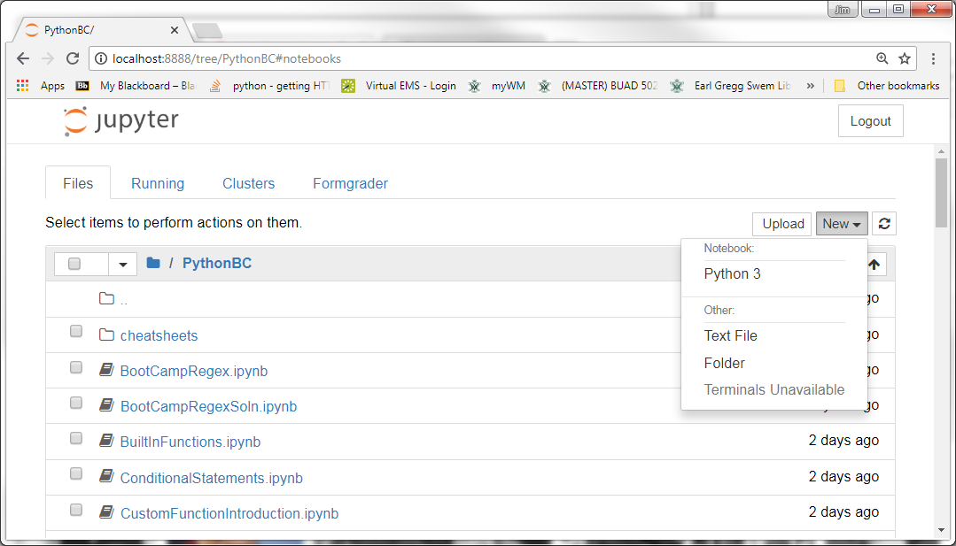
Jupyter Development Environment
Open new Jupyter notebook
Click on New
Choose Python 3
The 3 refers to Python 3.X versus 2.7
1
2

Slide 24
Introduction to Python Programming

Slide 25
References
Textbook
Severance, Chapter 2

Slide 26
Our First Python Statements
Create a new Jupyter notebook
Name it: FirstProgram
Type these statements into a Jupyter cell and simultaneously click Shift+Enter
print("Hello World!")
print('Hello World!')
Print('Hello World!')
x = 3
print(x)
print(X)
y = "Hello World!"
print(y)

Slide 27
Our First Python Statements
x and y in these statements are called variables:
x = 3
y = "Hello World!"
Think of a variable as a container
Assignment statements (with “=” sign):
Right-side computed, then transferred to left-side variable

Slide 28
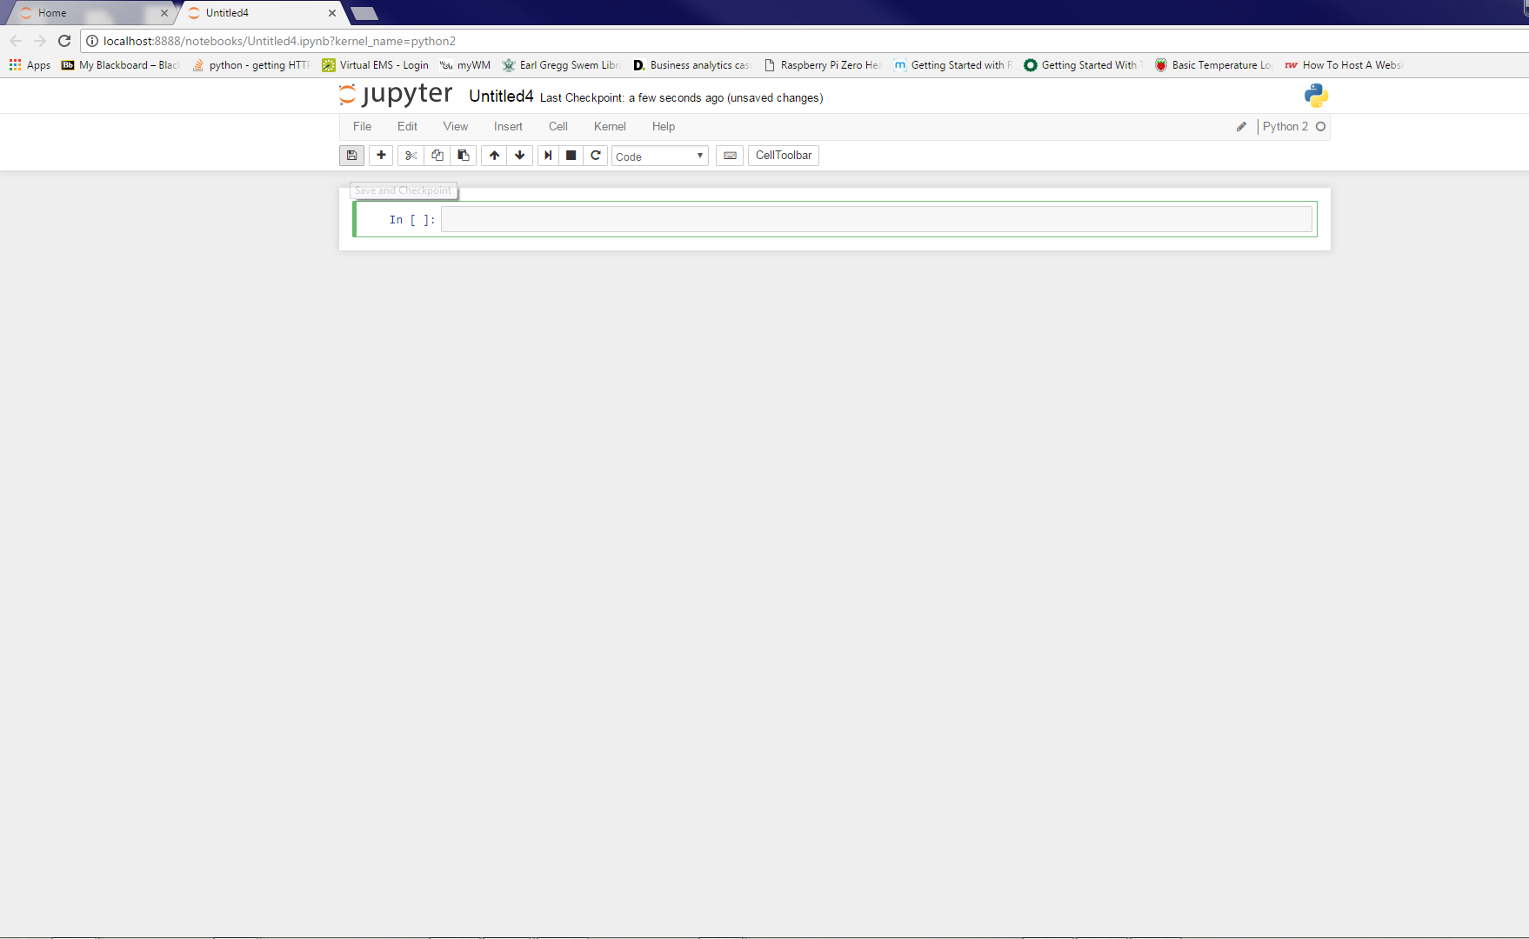
Jupyter Notebook Set-up
Rename the notebook
Click here

Slide 29
Jupyter Shortcuts/Hot Keys
Shift+Enter: execute current cell
Esc+x: delete current cell
Esc+a: insert cell above current cell
Esc+b: insert cell below current cell
Shift+Tab:
Typed after open parentheses shows method parameters
Esc+F: find within input cells (and Replace)
Ctrl+F: works for finding but no replace capability

Slide 30
Jupyter Shortcuts/Hot Keys
Esc+m: change cell to markdown
You must click on cell to enter markdown text
Shift+Enter: to execute markdown
Tab: code completion
Ctrl+Shift+P: get list of hot keys
Or with menu: Help-Keyboard Shortcuts
Ctrl+a: select all
Ctrl+z: undo
Ctrl+c, Ctrl+v: copy and paste, as usual

Slide 31
Jupyter Notebook Shutdown
Save the notebook

Slide 32
Jupyter Notebook Shutdown
Close a notebook
Save notebook
Go to the initial Jupyter browser window
Check the box next to the notebook
Click on Shutdown button
Close notebook browser tab
Close Jupyter
Follow instructions above for all notebooks
Click on Quit on home Jupyter page

Slide 33
Take-Aways
Shift+Enter executes code cells in Jupyter
Python is case sensitive
Remember to shut down Jupyter

Slide 34
Variables, Data Types, Statements & Operations

Slide 35
References
Textbook
Severance, Chapter 2
Files
VariableTypes.ipynb
MathOps.ipynb

Slide 36
Basic Variable Types
File: VariableTypes.ipynb
Recall:
Shift+Enter to execute statements
Type these statements into Jupyter
x = "hello"
type(x)
x = 'hello'
type(x)
x = 2
type(x)

Slide 37
Basic Variable Types
Statements
x = 2.7128128459045
type(x)
x = True
type(x)
x = true
type(x)

Slide 38
Basic Variable Types
Python automatically makes a variable the correct type depending on what data you assign to it
Unlike other programming languages where you need to declare variable types before you can assign data to them.

Slide 39
Basic Variable Types
str, string
float, floating point (with decimal)
int, integer (no fractional part)
bool, Boolean (True or False)
Python defines, and redefines a variable’s type depending on values you assign to it
Some errors are due to assigning data to a variable that is different than your intention

Slide 40
Quiz
What data type is 2.71828?
bool (Boolean)
int (Integer)
float (Floating Point)
str (String)
What data type is 21?
bool (Boolean)
int (Integer)
float (Floating Point)
str (String)

Slide 41
Quiz
What data type is 21.?
bool (Boolean)
int (Integer)
float (Floating Point)
str (String)
What data type is 'Hello World!'?
bool (Boolean)
int (Integer)
float (Floating Point)
str (String)

Slide 42
Type Conversion
See TypeConversion.ipynb
Variables can sometimes be converted to another data type

Slide 43
Basic Operations
Operation | Operator | Example | Notes
Addition | + | 1 + 2 | For numerical arguments
Subtraction | - | 9 - 4
Multiplication | * | 2×3 = 2*3
Division | / | 10/2
Division | // |  | Python 2 Style Division
Concatenation | + | "Go" + " Tribe" | For string arguments
Exponentiation | ** | 2³ = 2**3
Modulus | % | 9%2 = 1
Modulus is the “remainder operator”
The remainder after the second argument is divided into the first operator as many (integer) times as is possible

Slide 44
Operations & Variable Types
File: MathOps.ipynb
Computations with +, -, *,/, //, **, %
integer type if all data in a operation are integers
float type if any argument is float type
Exception: computations with division (/)
Results are always float type

Slide 45
Exercise
Modulus operator example…
A distribution center loads 53-foot trailers each of which can hold 800 cases. The day’s schedule calls for 4,150 cases to be packed for a particular destination.
How many full trailers will be shipped?
How many units will remain to be shipped the next day?

Slide 46
Exercises
Exponentiation
If you invest $1 at a compounded annual interest rate of 7%, then what is the investment’s value after 10 years?
Concatenation
Concatenate these two strings:
'Hello'
'World!'

Slide 47
Order of Operations
Fixed cost of a cell tower installation:
cost_fixed = 500000
Variable equip. cost per 100 calls (capacity):
cost_p_100 = 50000
Compute installation cost of 700-call tower:
cap = 700
Does this give the correct answer? Why?
cost_total = cost_fixed + cap * cost_p_100 / 100

Slide 48
Order of Operations
OrderOfOperations.ipynb
Compute the average of two numbers
Does this give the correct answer? Why?
x1 = 7
x2 = 11
avg1 = x1 + x2/2
print(avg1)

Slide 49
Order of Operations
Compute the average of two numbers
Does this give the correct answer? Why?
x1 = 7
x2 = 11
avg2 = (x1 + x2)/2
print(avg2)

Slide 50
Order of Operations
Computations are made from left to right, possibly in multiple passes, in this order:
Parenthetical operations
Statements in inner parentheses are computed before outer parenthetical statements
Exponentiation
Multiplication/Division
Addition/Subtraction
Parentheses are used to force the correct order of operations when they wouldn’t occur naturally.

Slide 51
Order of Operations
What values are assigned to x?
x = 1+10/2*5
x = 1+10/(2*5)
What is the result here:
(3+(4)**2*3+(28/7*2)/2*2)
Compute manually, verify with Spyder

Slide 52
Naming Variables
NamingVariables.ipynb
What happens when you execute this?
fixed overhead = 37
Variables cannot have spaces!!!
This is a syntax error
Which variable name is preferable?
x123 = 37
fixed_overhead_rate = 37
fixed_oh_rate = 37

Slide 53
Naming Variables
Naming advice
Use mnemonic names, but short as possible
Underscores
var_cost = 10
… or camel case
varCost = 10

Slide 54
Naming Variables
Type this into the Console Window
varCost = 10
What do these statements do?
print(varcost)
print(varCost)

Slide 55
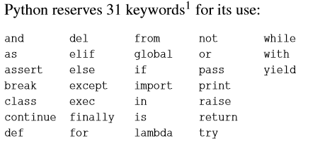
Naming Variables
You cannot use these keywords to name variables (image from Severance book)
Additional keywords will be off limits depending on what packages you have loaded

Slide 56
Quiz
Assume that you are writing a computer program that requires that requires a variable for the current temperature in Williamsburg, VA. What do you think is the best variable name for this data?
wt
current_temperature_in_Williamsburg_Virginia
tempCurWburg
currentTemperatureWilliamsburgVirginia

Slide 57
Quiz
Assume that you are writing a computer program that monitors the price of an article on ebay.com, which is a VHS tape of the original Star Wars movie.
What do you think is the best variable name for this data?
x
sw
priceStarWars
currentPriceOriginalStarWarsVHSScrapedFromEBay

Slide 58
Typical Errors
Case sensitivity
Not typing variable names or functions using the proper case

Slide 59
Built-in Python Functions
Examples:
Reference
https://docs.python.org/3.7/library/functions.html
x = 2
y = 3
print(min(x,y))
print(max(x,y))
print(pow(x,y))

Slide 60
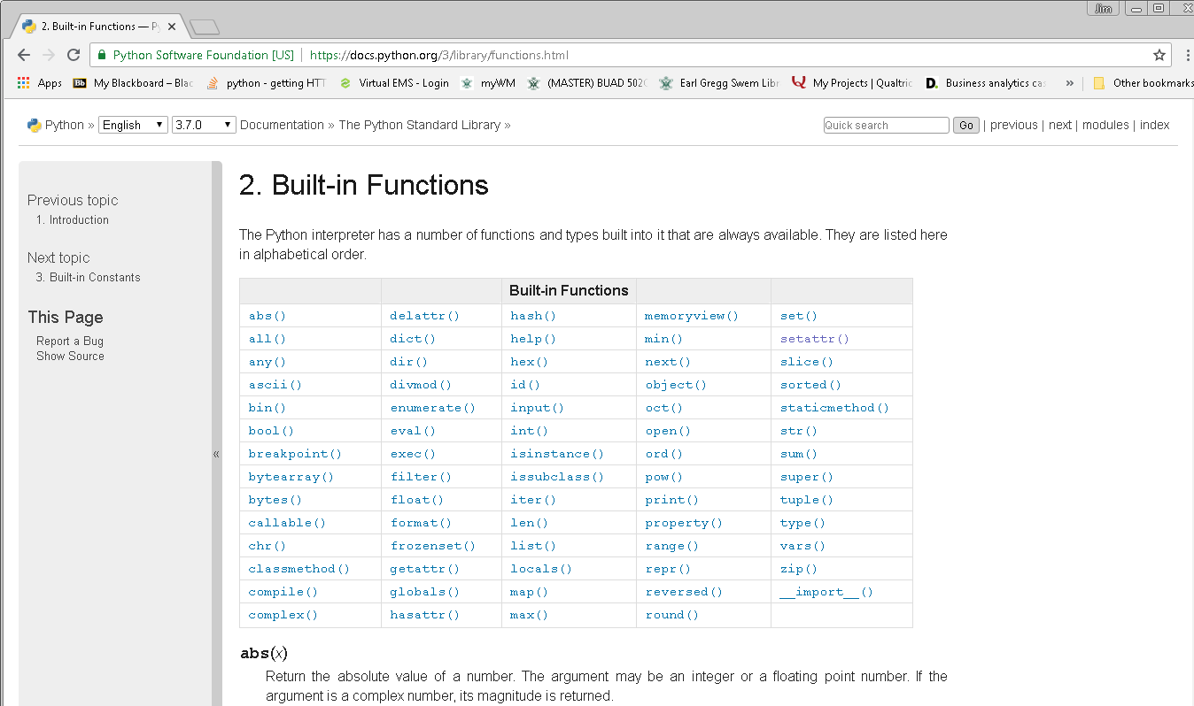
Built-in Python Functions
Example:
Reference
https://docs.python.org/3/library/functions.html
myStr = 'hello'
print(len(myStr))

Slide 61
Additional Math Functions
This statement “loads” a package (code you can’t see, but you can use) that defines new math functions:
import math
Examples
math.pow(x,y)
x^{y}
math.log(x)
natural logarithm
math exp(x)
e^{x}
math.log10()
base 10 logarithm
math.sqrt()
square root
math.fabs()
absolute value
math.ceil()
ceiling
math.floor()
floor

Slide 62
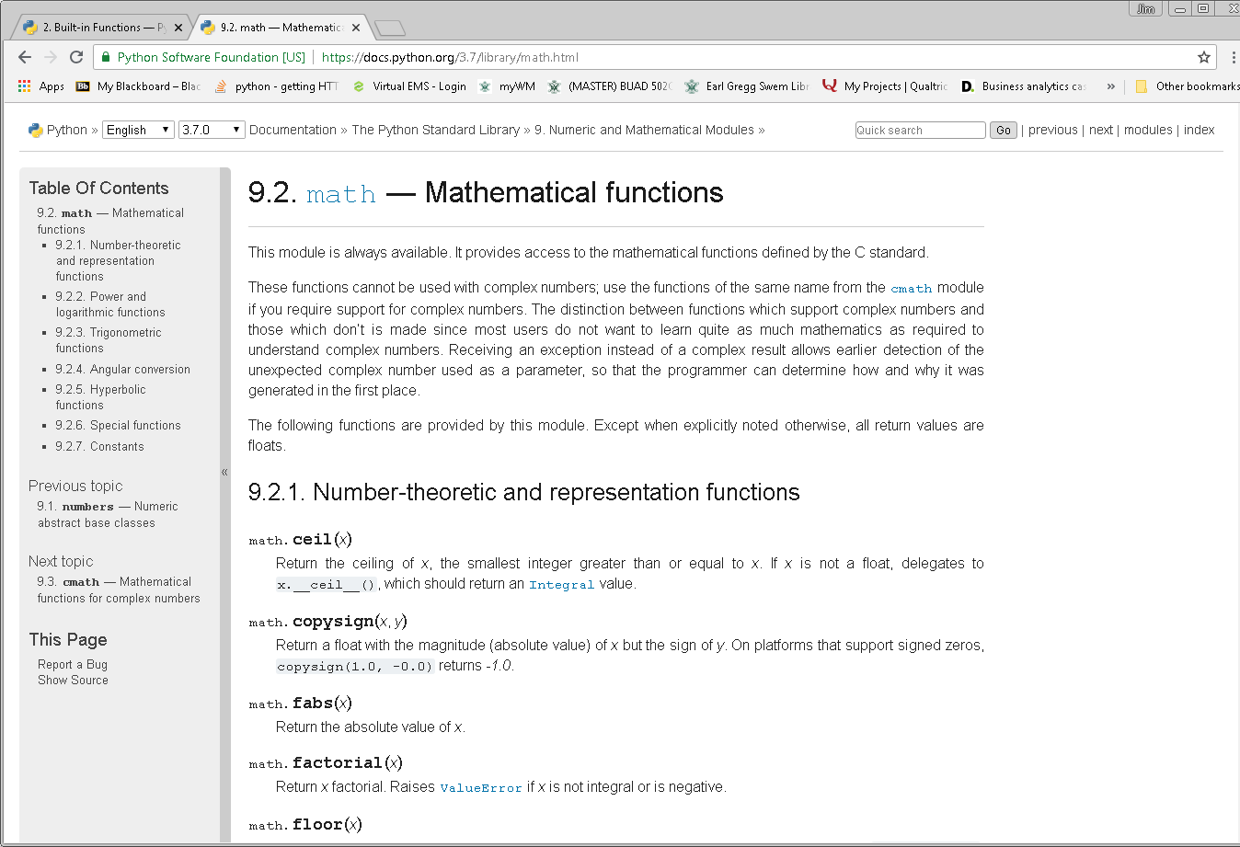
Additional Math Functions
https://docs.python.org/3.7/library/math.html

Slide 63
Input from the Keyboard

Slide 64
Reference
Textbook
Severance, 2.10

Slide 65
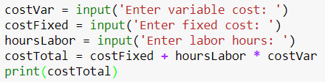
Keyboard Input
Statement for keyboard input:
input(prompt_string)
Assigns input to a variable
See KeyboardInput.ipynb

Slide 66
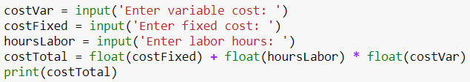
Keyboard Input
input()yields string data
Convert data to float
float()

Slide 67
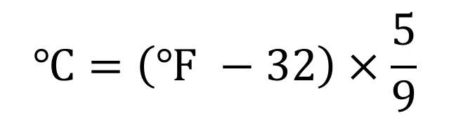
In-Class Exercise
Write a program to convert a Farenheit temperature entered via input()into a Celsius temperature.
Print out a message that looks like this, assuming a user had entered 32 degrees:
'The Celsius equivalent of the temperature you entered, 32 degrees, is 0 degrees Celsius.'
$$℃=\left(℉ −32\right)×\frac{5}{9}$$

Slide 68
Homework
Exercise 2.3, pg. 30
Exercise 2.4, pg. 30
Exercise 2.5, pg. 30-1
We’ve already done this as an in-class exercise

Slide 69
Boolean Expressions and Conditional Statements

Slide 70
References
Textbook
Severance, Chapter 3
Boolean statements are the foundation for conditional statements

Slide 71
Boolean Statements
Boolean statements are either True or False
Type these into the Spyder console window:
x = 3
print(x == 3)
print(x == 4)
Notice the double equals signs… try this
print(x=3)
= is for assignment
== is a logical comparison (True or False)

Slide 72
Boolean Statements
Boolean variables are either True or False
Type these lines into the console window:
x = 3
y = x == 3
print(y)
z = x == 4
print(z)
y and z are Boolean variables

Slide 73
Boolean Statements
Boolean Comparison | Description
== | Tests whether two variables have the same value
!= | Not equal to
> | Greater than
>= | Greater than or equal to
< | Less than
<= | Less than or equal to
is | Test where two variables are the same object (i.e., same data type, same position in memory, same value)

Slide 74
Boolean Statements
Examples
x = 4
y = 5
print(x == y)
print(x < y)
print(x > y)
x = 3
y = 3.0
print(type(x))
print(type(y))
print(x == y)
print(x is y)
Notes:
Test z1 = [1,2], z2 = [1,2] with is operator

Slide 75
Boolean Statements
Boolean Operators | Meaning
not | Negates Boolean statement
and | Tests whether both Boolean statements are true
or | Tests whether one or both of two Boolean statements are true
^ | Exclusive Or
x = 4
y = 5
print(x==y)
print(not(x==y))
print()
print(x<y)
print(not(x<y))
print((x<5) and (y>5))
print((x<4) or (y>5))

Slide 76
Conditional Statements
Pick at most one code block to execute depending on situation
if-elif-else statements rely on Boolean expressions
if Boolean_stmt_1:
execute if Boolean_stmt_1 True
elif Boolean_stmt_2:
execute if Boolean_stmt_2 True
else:
execute in all other cases

Slide 77
Conditional Statements
Structure
if, required
elif, optional
Contraction of “else if”
Code block executed if previous code blocks are not executed and condition elif is true
Can be multiple elifs
else, optional
Code block executed if none before are
Don’t forget colons after each if, elif, else
Indents for “code blocks” required
Also for readability
2 or 4 spaces, some environments require 4 spaces

Slide 78
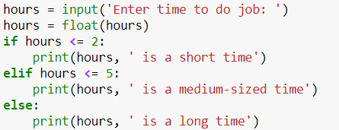
Conditional Statements
ConditionalStatements.ipynb

Slide 79
In-Class Exercise
Write program in Jupyter that:
Accepts an integer as input via input()
Determines whether the number is odd or even and prints out the (1) the number and (2) either “odd” or “even” as is appropriate
Save as OddEven.ipynb

Slide 80
Conditional Statements
Another conditional statement
When there is a chance a statement will cause (throw) an error, use Try-Except:
try:
do_something_here
except:
code block runs upon error

Slide 81
Conditional Statements
Will this code always work?
Hint. Try this conversion in a Jupyter cell:
How could try-except be used to improve this code?
float('text')

Slide 82
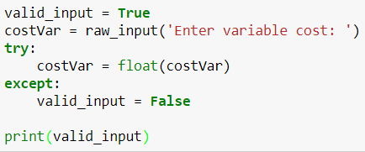
Conditional Statements
Let’s fix prior code for one variable
ConditionalStatements.ipynb

Slide 83
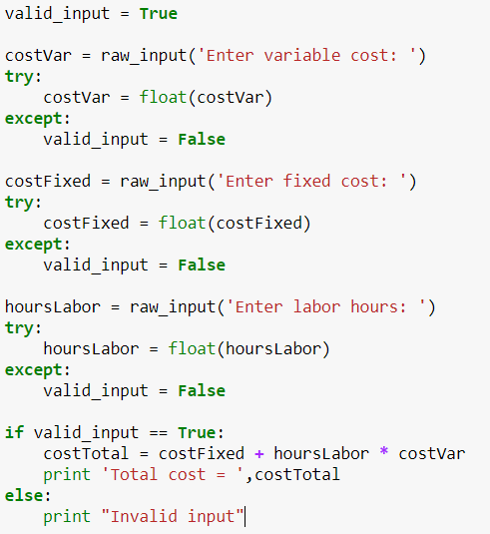
Conditional Statements
Fix all variables: 3 try-except instances:

Slide 84
Conditional Statements
Try this
ConditionalStatements.ipynb
Guardian Pattern
After evaluation of each term in a Boolean statement the evaluation of the statement is halted if it is clear it will be false
y = 1
x = 0
print(y<2 and x<5 and y/x >10)
y = 1
x = 0
print(y<2 and x!=0 and x<5 and y/x >10)

Slide 85
In-Class Exercise
Implement the Fahrenheit-Celsius conversion using try-except to detect acceptable input data

Slide 86
Typical Errors
Indentation errors
Not indenting code under if-else blocks, try-except structures
Not having proper or consistent indentation under if-else, try-except structures
Not starting lines on first space
Some development environments require 4 spaces of indentation

Slide 87
Homework
Exercises 3.1 – 3.3, pp. 40-41

Slide 88
Commenting and Markdown

Slide 89
References
Textbook
Severance, Section 2.11
Severance really doesn’t comment much on commenting
No mention of “markdown” because his book doesn’t use Jupyter
Only Jupyter uses markdown

Slide 90
Commenting Code
2 methods
# comments out remainder of a line
""" comments out all lines until next ""“
In both Spyder and Jupyter (all Python programs)
Commenting code is important
You will soon forget the details of what you did and how you did it
Give yourself, and whomever may use your code, a chance of understanding how it is constructed

Slide 91
Markdown
Jupyter provides excellent documentation capabilities
Can create an effective visual “report” with text, typeset text, graphs, computations, etc.
Example: MarkdownExample.ipynb
Create a markdown cell
Esc+m
You’ll need to re-click back in the cell to enter text
Still use Shift+Enter to “execute”

Slide 92
Functions

Slide 93
References
Textbook
Severance, Chapter 4

Slide 94
Functions
We’ve already used some built-in functions:
max(), min(), str(), int(), float(), len(), pow()
Syntax/terminology
In this statement, str(4):
“str” is the function
4 is the argument
In this statement min(2,3):
“min” is the function
2 & 3 are the arguments

Slide 95
Functions
We will use these later:
range(): create a list of numbers
abs(): absolute value
sum(): sum of numbers
open(): open a data file for input
Built-in Python functions (again):
https://docs.python.org/3.7/library/functions.html

Slide 96
Custom Functions
We can also write our own custom functions
We’ll show an example that demonstrates how to write a function and why you would want to do it

Slide 97
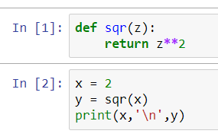
Simple Function Example
CustomFunctionIntroduction.ipynb
A function:
Has input an output
Is reusable
Can be called from other parts of our code

Slide 98
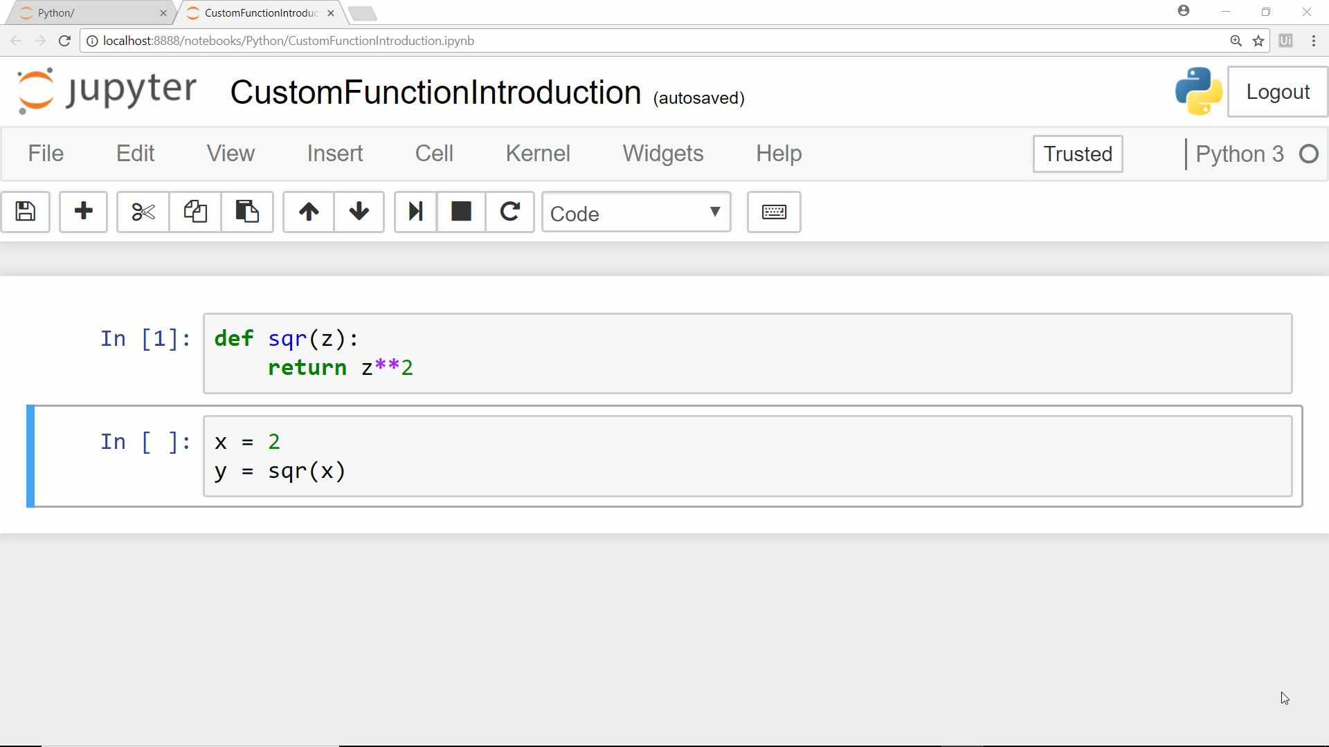
Simple Function Example

Slide 99
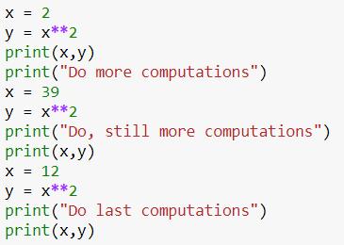
Benefits of Functions

Slide 100
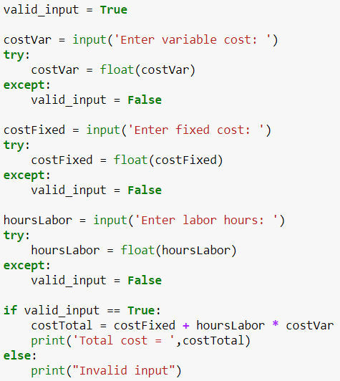
Custom Functions
Can functions improve this code from ConditionalStatements.ipynb?

Slide 101
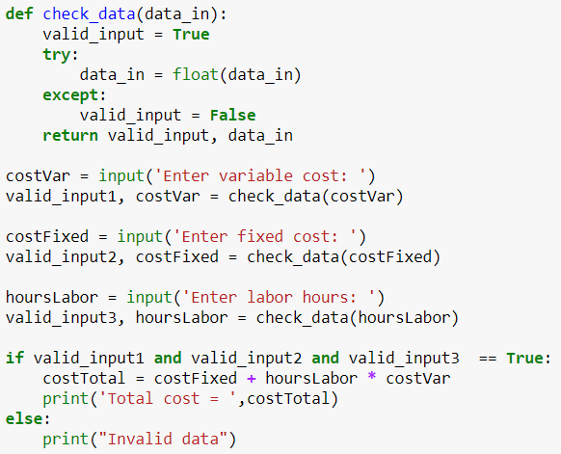
Custom Functions
A custom function to convert string data to float data
Function declaration
Passed parameter
Indentation
Return statement

Slide 102
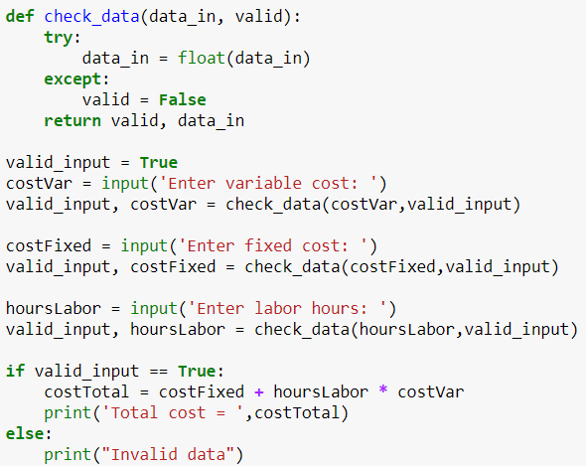
Custom Functions
An improvement

Slide 103
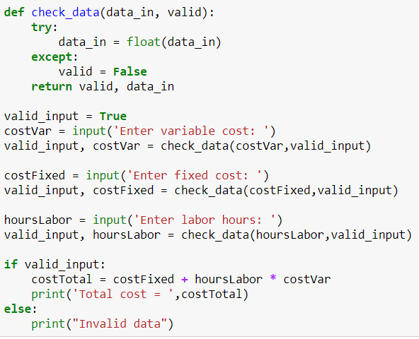
Custom Functions
Even better

Slide 104
Custom Functions
Benefits of functions:
Only one instance of code to maintain
Less time to revise code
Fewer errors because you don’t miss revising an instance
Clearer code, more understandable
Shorter code
Provides for code reuse
Functions are easily reused—modular
… digging lines here and there out of a program takes longer and is fraught with error
Saves time writing code later

Slide 105
In-Class Exercise
Write a custom function that receives one argument, temperature on the Fahrenheit scale, and returns temperature on the Celsius scale
Start with the code you’ve written before
Include data validation

Slide 106
In-Class Exercise
Write a function that receives a list of numerical values and returns the minimum, maximum, and average of those four values
Then, print out those three returned values in the main program

Slide 107
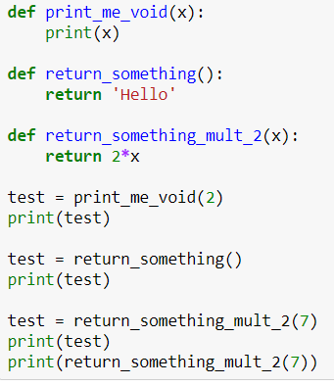
Function Output
Some functions return values, some do not
“Fruitful” (Severance) versus void functions
In CustomFunctionsIntroduction.ipynb

Slide 108
Youtube Video on Functions
https://www.youtube.com/watch?v=Lhno4T53vcg&t=1s&index=5&list=PLxYh7ZSzU5052ugdqSbsVvfqU1jQVOJTI

Slide 109
Homework & In-Class Exercises
Exercises 4.4 – 4.7, pp. 54-55

Slide 110
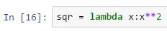
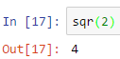
Lambda Functions
Lambda functions are a “short cut” for specifying simple functions
Create a named function syntax
Using the lambda function
Name of function
Dummy variable for input
How the lambda function transforms the input to output

Slide 111
Homework
Create a lambda function that computes the cost of cell tower construction
The argument passed to the lambda function is the number of calls capacity for the tower
The fixed construction cost is $50,000
The variable cost per call is $5,000
Test the lambda function in some code

Slide 112
Homework & In-Class Exercise
lambda functions can take multiple input arguments
Create a lambda function that, taking two arguments, returns the maximum of the two
Test the lambda function in some code
This problem requires you to experiment or do a Google search

Slide 113
Homework
Write a program, using a lambda function, to compute the Euclidean distance between two 2-dimensional points.

Slide 114
Spyder Development Environment

Slide 115
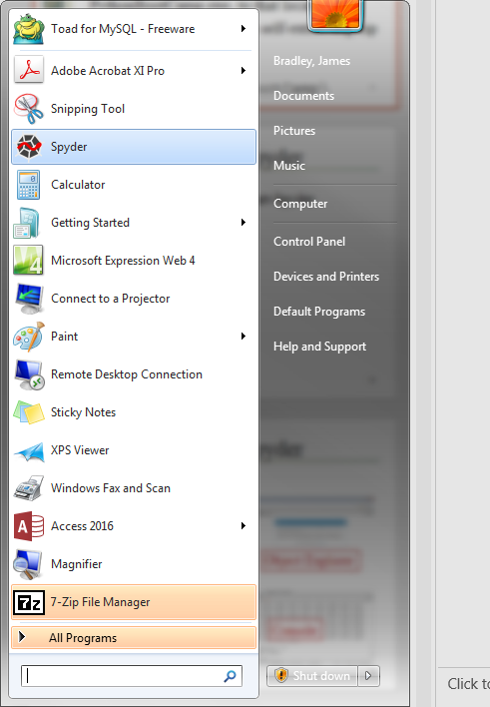
Spyder
Start Anaconda Spyder from Start button

Slide 116
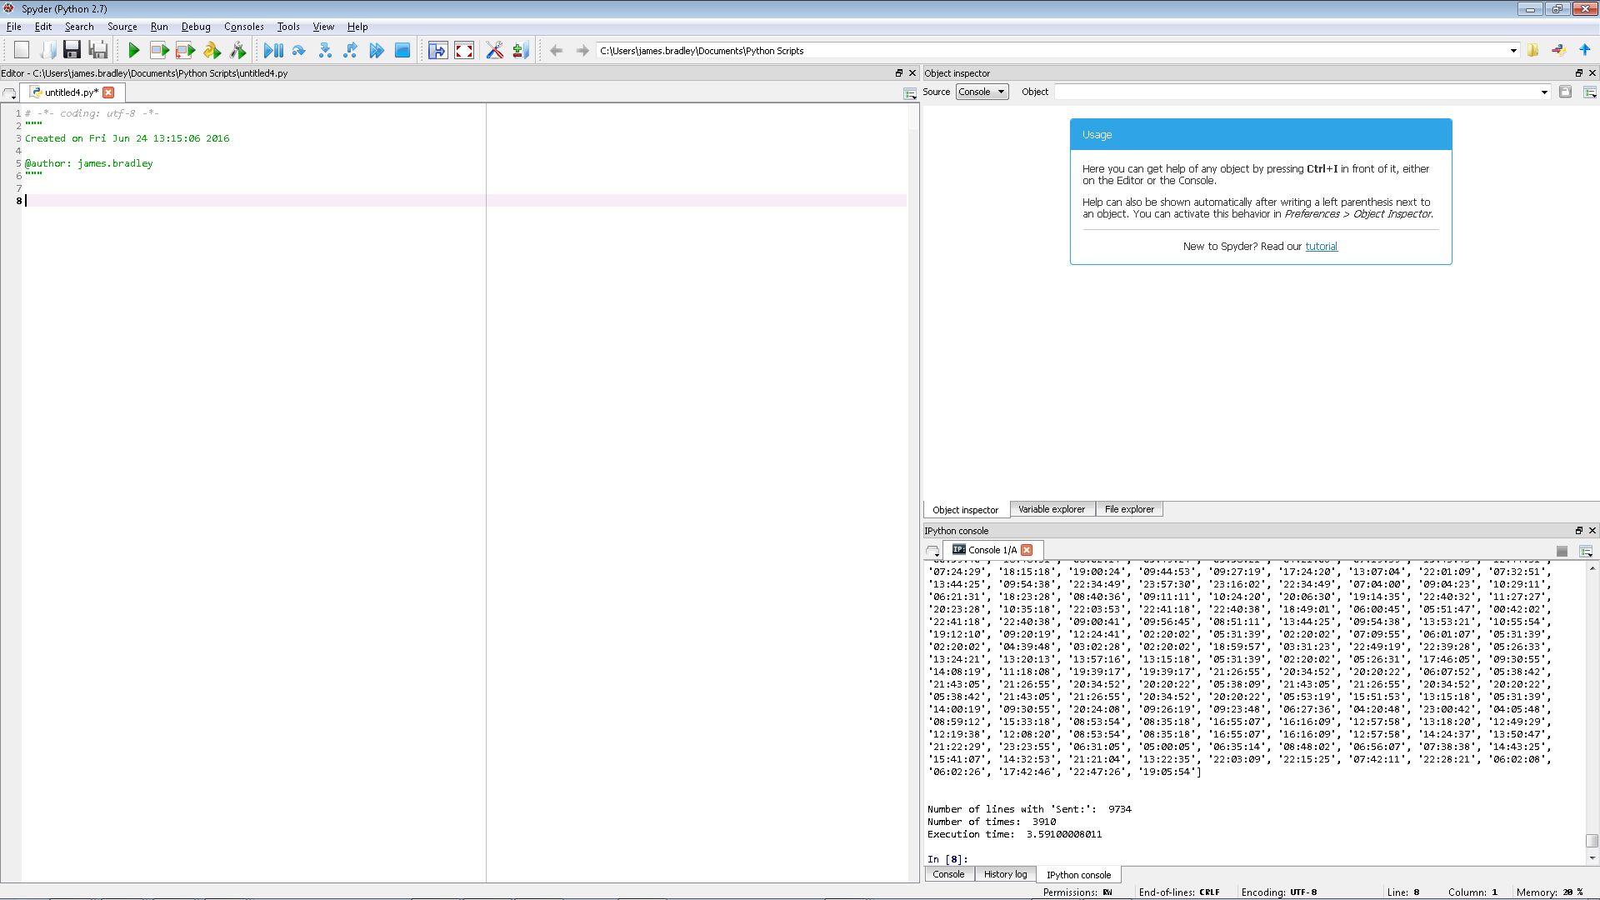
Spyder
Start Anaconda Spyder
Object Explorer
Script Editor
Write many lines of code for sequential execution here
Console
Run 1 or a few lines of code here

Slide 117
Script/Program
Let’s put these in the Script Editor window in Spyder and run altogether:
x1 = 7
x2 = 11
avg = (x1 + x2)/2
print(avg)
Then, we can save the file to this folder:
C:\Users\[your_username]\
…with filename avg.py

Slide 118
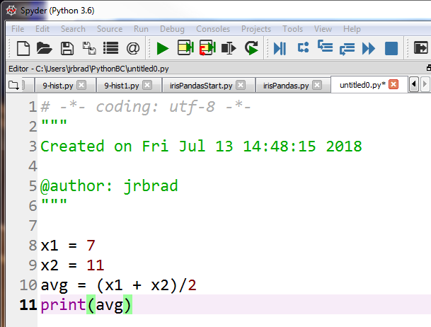
Script/Program
Run the program by clicking on the green triangle as shown below or click F5

Slide 119
Debugging

Slide 120
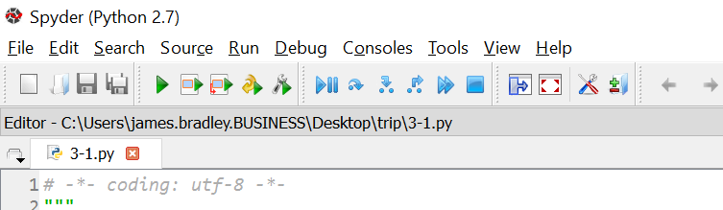
Debugging
Break points
Using the terminal window/console to debug
Start running, stop at first breakpoint
Execute one line of code
Execute until next breakpoint
Stop
Notes:
Breakpoints may be defined in the Editor.
Simple breakpoints can be set from the Run menu, by keyboard shortcut (F12 by default), or by double-click to the left of line numbers in the Editor.
Conditional breakpoints can also be set from the Run menu, by keyboard shortcut (Shift+F12 by default), or by Shift+double-click to the left of line numbers in the Editor.
Can’t set from Run menu in Spyder 2.7

Slide 121
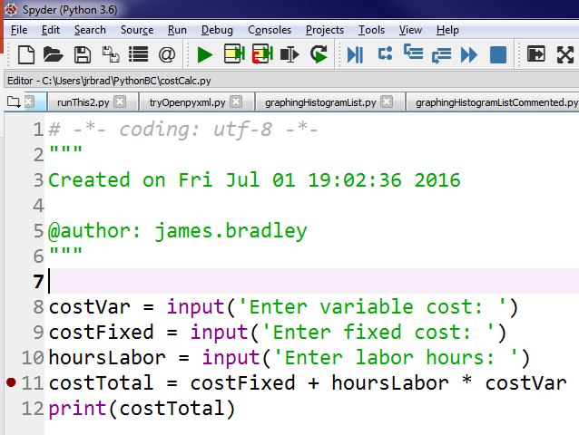
Debugging
Breakpoints
Double-click on gray area left of row numbers
Program execution stops before these breakpoints are executed

Slide 122
Debugging
Breakpoints
Values of variable can be assessed in the Console Window when execution is paused at a breakpoint
Can also view variable values in Variable Explorer window
Print statements are often used for debugging

Slide 123
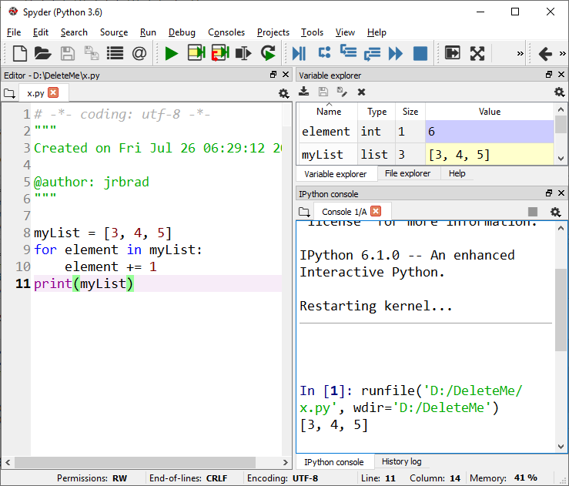
Debugging
Can also view variable values in Variable Explorer window

Slide 124
Beware
Both Jupyter and Spyder retain variable definitions from all code that is executed
Those definitions will be used when other code files (Spyder) and cells (Jupyter) are executed
Open these files in Spyder:
x.py
y.py

Slide 125
Errors
Errors will happen
You will get faster in recognizing your errors
Debugging
We’ll show you methods to find errors
Sometimes errors do not result in error messages
With experience you will make each mistake less often and recognize and fix errors faster

Slide 126
Debugging Resources
When debugging, Google it
But it takes experience to search effectively
Better search terms will give you the better results
Takes time to learn best search terms
Need instinct for knowing which advice is best
When you’ve found something likely to work
Which sites to trust
For example, what I’ve learned…
Give preference to stackoverflow.com
If you’ve Googled unsuccessfully for 15 minutes:
You’re not using the best search terms
Your problem is so rare that you need to reboot

Slide 127
Error Types
Syntax Errors
print('Hello World!)
Print('Hello World!')
print "Hello World"
Logic Errors
x or y (but you really meant and)
Semantic Errors (e.g., computing an average):
x1 = 7
x2 = 11
avg = x1 +x2/2

Slide 128
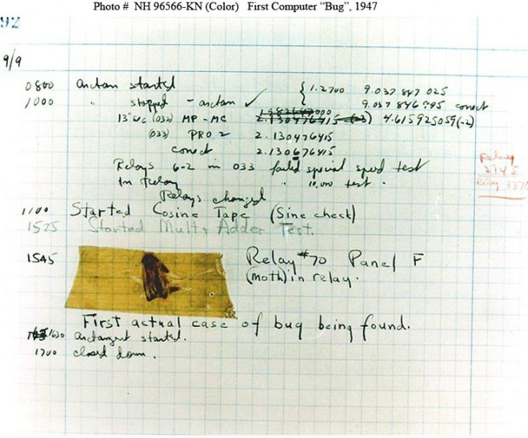

Origins of Debugging
Grace Hopper and a Moth
https://www.wired.com/2013/12/googles-doodle-honors-grace-hopper-and-entomology/
https://en.wikipedia.org/wiki/Grace_Hopper
* https://www.wired.com/2013/12/googles-doodle-honors-grace-hopper-and-entomology/

Slide 129
Spyder versus Jupyter
Each has its strengths
I will use Jupyter for introducing material
Markdown permits documentation
We will use Spyder for exercises
Better debugging than Jupyter

Slide 130
Lists Data Type

Slide 131
References
Textbook
Severance, Chapter 8

Slide 132
Data Types
int
float
str
bool
list
tuple
dict (dictionary)

Slide 133
Lists
[7, 2, 5, 3, 1, 9, 8]
A list is simply a list of data objects
Values in a list need not all be of the same type
… but usually they are
Lists are specified with brackets
[the list elements are in here separated by commas]
The elements in a list are separated by commas
List elements can be lists, tuples, & dictionaries…
We’ll talk about this later
Mutable
Elements can be changed

Slide 134
Lists
Execute these statements in the Spyder Console or a Jupyter cell:
List elements are read and written using their indices: each index is the “address” of its corresponding element
Indices start at 0
For example, myList[0] = 7
myList = [7, 2, 5, 3, 1, 9, 8]
print(type(myList))
Indices: 0 1 2 3 4 5 6
Elements:[7, 2, 5, 3, 1, 9, 8]

Slide 135
Lists
You can also access the elements counting from the end of the list by using a minus sign with the index:
E.g., myList[-2] = 9
Negative sign means relative position from the end of a list

Slide 136
Lists
How many elements are in a list?
list.append() inserts an element onto the end of a list
The method accepts one argument
Example
myList.append(6)
Note that the six is not a list, just a number
len(myList)

Slide 137
In-Class Exercise
Use the list.append() method to append 4 to myList.

Slide 138
Lists
You can also append using the + sign
Appending to lists:
test_list.append(13)
test_list = test_list +[13]
test_list.append([13])
test_list = test_list.append([13])
test_list = test_list + 13
test_list + 13
Red means incorrect or probably not what you want to do

Slide 139
Lists
Here’s the difference:
.append() directly changes the list and returns nothing
Do not set it equal to some variable
+ creates a new list, doesn’t change old list
You need to set it equal to a variable to catch results
Confusing to have two append methods?
Advice
Pick one method and use it consistently

Slide 140
Lists
myList.extend() is similar to append, except that its argument is a list
The list in the parentheses is concatenated onto myList
Example
myList.extend([11,12,14])
Note that the argument is a list

Slide 141
Lists
Appending a list into a list
myListInt = [[0,1,2,3],[3,0,1,2],[2,3,0,1]]
myListInt.append([1,2,3,0])
print(myListInt)
myListInt = [[0,1,2,3],[3,0,1,2],[2,3,0,1]]
myListInt.extend([[1,2,3,0]])
print(myListInt)

Slide 142
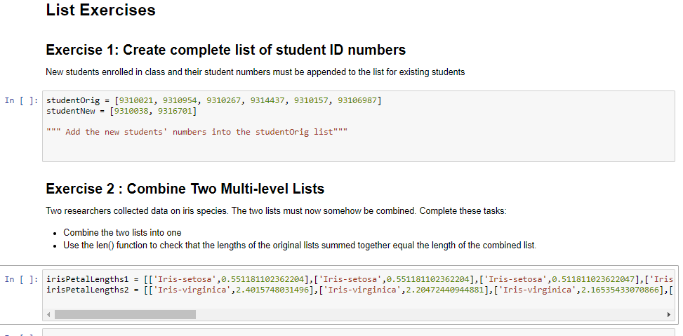
Exercise
Complete the exercises in Lists.ipynb under the List Exercises heading

Slide 143
Lists
Create a range encompassing the indices of myList using the range() function:
This will be convenient for loops:
This is an often-used code pattern:
Cycles through all list elements without knowing beforehand how many there are
range(len(myList))
list(range(len(myList)))
for i in range(len(myList)):
print(i, myList[i])

Slide 144
Lists
Another version of range() function
range(i,j) creates a list with integer elements starting at i and ending with j-1

Slide 145
Range
Still another version of range()
range(start,stop[,step])
Creates a ‘list’ of numbers which:
Starts at the value start
Default start = 0
[] means step is optional argument
Default step is 1
Ends at the greatest possible value such that start + n×step that is less than stop
https://docs.python.org/2/library/functions.html#range
start/stop/step must be integers

Slide 146
In-Class Exercise
Use only the range(start,stop[,step]) function to create a list of even numbers starting at 2 and ending with 20.

Slide 147
Lists
Lists of strings
Lists of lists
How do we access the numerical elements?
Specifically, how would you access 6?
myListStr = ['zero','one','two']
myListInt = [[0,1,2,3],[4,5,6,7],[8,9,10,11]]

Slide 148
Lists
What is your guess about what this will do?
Hierarchical
First index accesses elements in outer list
Each successive index dives one level “deeper” into a list of lists
How many elements are in the 2nd sub-list?
print(len(myListInt[1]))
myListInt = [[0,1,2,3],[4,5,6,7],[8,9,10,11]]
print(myListInt[1][1])

Slide 149
In-Class Exercise
How would you access the value 5?
How would you access 10 in myList2?
myList2 = [[[0,1],[2,3],[4,5]],[[6,7],[8,9],[10,11]]]

Slide 150
In-Class Exercise
How would you access the value 10?
How would you access 23 in myList3?
myList2 = [[[0,1,2],[3,4,5],[6,7,8]],[[9,10,11],[12,13,14],[15,16,17]],[[18,19,20],[21,22,23],[24,25,26]]]

Slide 151
Lists
Lists are mutable
List values can be changed
Change a value in myList:
myList[0] = 99

Slide 152
Lists
Initializing an empty list:
myList2 = []
Sometimes initializing lists of a certain size is useful….
The * operator here means create a multiplicity of items rather than multiplication
Any guesses what this will do?
myList4 = [[1,1,1,1]]*4
myList3 = [1]*5

Slide 153
Lists
Getting a “Slice” of a list means to extract a subset from the list

Slide 154
List Slice Techniques
Index x through y-1
t[x:y]
Beginning to element with index y-1
t[:y]
From element with index x until end of list
t[x:]
Negative sign means relative position from the end of a list
Element y places from end of list
t[-y]
Range of elements relative to end of the list
t[x:-y] or t[-x:-y]

Slide 155
Exercise
See exercises in Lists.ipynb

Slide 156
Lists
Crash course on object orientation
Lists are objects as are all Python data types
Lists (and object) come with these features
Properties (attributes)
Information about the object
Methods (functions)
Alters the object or uses the object data in a computation
Specify a property or method by typing a period after the object name: myList.
See available properties & methods:
Spyder: by just typing the dot (period)
Jupyter: type dot and click Tab
The variable/object must be defined already

Slide 157
Lists
List methods
Sort list in ascending order
.sort()
This sorts the list in place: does not return an value
Sort list in descending order
.sort(reverse=True)
Remove last element from list and return it
.pop()
Remove element from list by index and return it
.pop([index])
Remove element from list by value
.remove(value)

Slide 158
Exercises
See exercises in “List Methods” section of Lists.ipynb

Slide 159
Lists
Can also sort with the built-in Python function sorted()
sorted(myList)
Does not perform sort in place
Rather, it returns a copy of the sorted entity
Be careful of methods that return copies and those that perform operations on the entity in place

Slide 160
Lists
Other built-in functions that operate on lists:
len(myList)
del myList
del myList [2]
del myList [1:3]
min(myList)
max(myList)
sum(myList)

Slide 161
Lists
Unsure about whether a statement will work?
Test it in Spyder Console or in Jupyter

Slide 162
In-Class Exercise
Write code that:
Creates a list of integers from 0 to 15
Deletes the elements in positions corresponding to indices 2, 5, and 7
Prints out the min, max, sum, and average of the remaining elements

Slide 163
Lists and Functions
Numerical quantities and lists are treated differently when passed to functions
Let’s go through the examples in the “Passing Lists to Functions” section of Lists.ipynb
It is critical to know:
Whether copies of the parameters are sent to function versus pointers to the actual variables in memory
Whether you need to rely on a return value or modify the variable directly in the function

Slide 164
In-Class Exercise
Write a function the deletes the last element of a list which is passed to it as an argument, and then returns the truncated list
Solution
DeleteListElementFunctions.ipynb

Slide 165
Aliasing
p = 3
q = p
p = 1
print(p)
print(q)
print(p is q)
This behavior is intuitive for numerical quantities

Slide 166
Aliasing
p = [1,2,3]
q = p
q[1] = 9
print(p)
print(q)
print(p is q)
What are the values of p and q?
Are they the same of difference variables?

Slide 167
Aliasing
p = [1,2,3]
q = p
q[1] = 9
print(p)
print(q)
This is aliasing
… not necessarily intuitive
In this case, p and q both reference the same location in memory
You are not creating a new object in memory referenced by q

Slide 168
Aliasing
How to avoid aliasing (when you want to):
Make a copy of the list
Be careful of unnecessary copies of lists
Consumes memory
p = [1,2,3]
q = p[:]
q[1] = 9
print(p)
print(q)

Slide 169
Set Data Type

Slide 170
Set Data Type
Not used as frequently as other data types
These slides are for awareness
A set can be viewed as:
A list where an item can occur only once
Designated by curly braces, {}
There is also the frozenset data type
It is immutable
Advantages
Use to eliminate redundancies in lists
Lookup speed

Slide 171
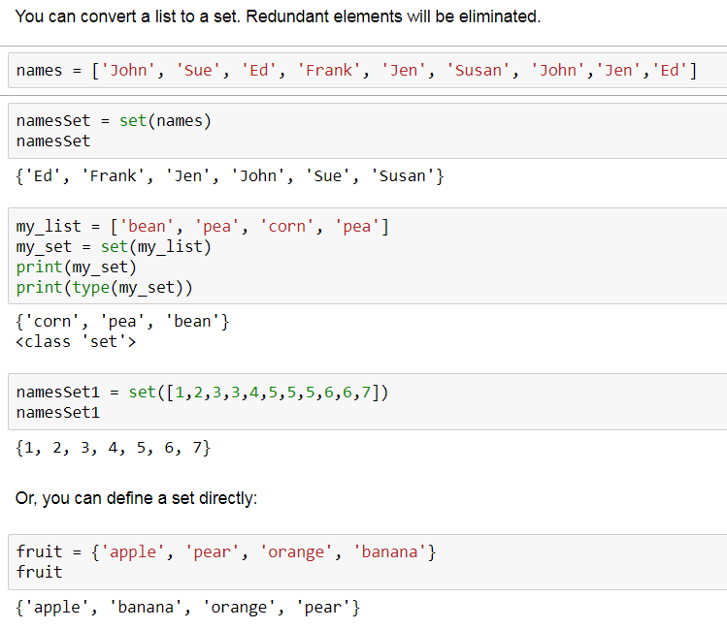
Set Data Type
Sets.ipynb

Slide 172
Set Data Type
set data types are mutable
.add()
.remove()
frozenset data types are immutable
Cannot .add() or .remove()
Both data types are iterable, can use in:
for loops
List comprehension

Slide 173
Set Data Type
Can check if item x is in a set, or not
if x in this_set:
if x not in this_set:
Check if this_set is subset of that_set
if this_set.issubset(that_set):
if this_set ≤ that_set:
Is this_set is superset of that_set?
if this_set.issuperset(that_set):
if this_set ≥ that_set:

Slide 174
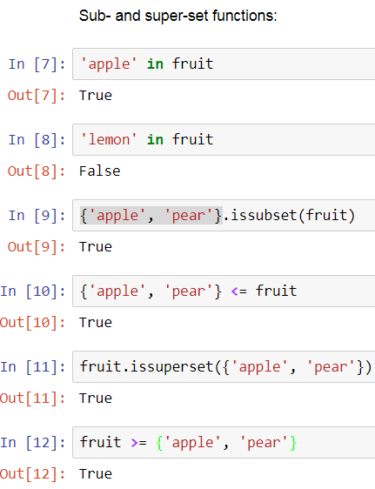
Set Data Type
Sets.ipynb

Slide 175
Set Data Type
Other set methods to know about:
set.union(set1, set2)
set.intersection(set1, set2)
my_set.clear()
x = my_set.pop()
Removes first element of my_set and assigns it to x
my_set.add()
my_set.remove()

Slide 176
Loops
For loops
While loops
2D For loops

Slide 177
References
Textbook
Severance, Chapter 5

Slide 178
Loops
Computers are powerful because they rapidly, repeatedly execute code
Loops are key to rapid, repeated execution of code blocks:
Execute code a known number of times
for loops
Execute code an unknown number of times
Until some criterion is satisfied
while loops

Slide 179
Loops
for-loop Structure
Known number of iterations through loop
for i in [3, 4, 5]:
print(i)
Performs the indented steps 3 times with, sequentially, i=0, i=1, i=2
Any data type can be placed here as long as it is iterable: lists, tuples, dictionaries, ranges, …
myList = [3, 4, 5]
for i in myList:
print(i)
myList = [3, 4, 5]
for i in range(len(myList)):
print(i,myList[i])

Slide 180
Lists, Loops, and Variable Names
Wise variable name choices make loop syntax read like English
That is, mnemonic, descriptive names
for row in table:
for element in row:
for word in words:

Slide 181
Loops
Sometimes you want to modify list elements in a for loop
One of these works, and the other doesn’t
myList = [3, 4, 5]
for element in myList:
element += 1
print(myList)
myList = [3, 4, 5]
for i in range(len(myList)):
myList[i] += 1
print(myList)

Slide 182
In-Class Exercise
Compute the sum of the first 10 terms of this summation using a for loop:
1 + x + x² + x³ + x⁴ +…
… for any value 0.0 < x < 1.0
Let’s try x = 0.5
Input x with input()function

Slide 183
Loops
Typical while loop code
Loop keeps iterating as long as this Boolean statement is True
keep_going = True
i = 0
while keep_going == True:
i = i + 1
if i**2 >= 100:
keep_going = False

Slide 184
In-Class Exercise
Use the loop structure on the previous slide
Use a while loop to compute the series
1 + x + x² + x³ + x⁴ +…
Directions
Input x with input() function
0.0 < x < 1.0
Keep adding additional terms while the incremental terms are greater than 10⁻⁸

Slide 185
Loops
Loop control
break breaks out from the lowest level for or while loop
continue skips remainder of the current loop iteration and proceeds with the next iteration
Let’s revise the last program to use these concepts

Slide 186
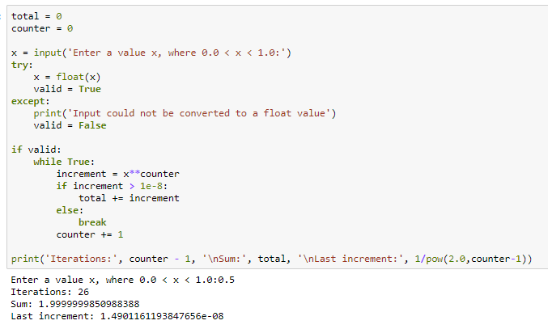
Loops
break and continue examples
Revise the last program to use break
See Loops.ipynb

Slide 187
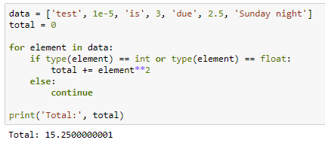
Loops
break and continue examples
Iterate through a list… adding all the elements that are either integers or floats
Uses continue
See Loops.ipynb

Slide 188
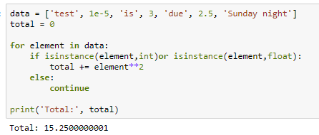
Loops
break and continue examples
Iterate through a list… adding all the elements that are either integers or floats
Another approach
See Loops.ipynb

Slide 189
For Loops—Summary
Iterate directly through elements
Iterate using indices
Can loop through any iterable:
Tuples
Dictionaries
Many more data types
myList = [3, 4, 5]
for element in myList:
print(element)
myList = [3, 4, 5]
for i in range(len(myList)):
print(myList[i])

Slide 190
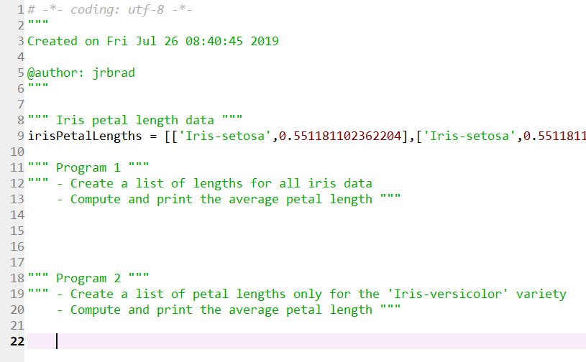
Exercise
Exercise 5.1, pg. 64-5
Open iris.py in Spyder and complete the two programs in it

Slide 191
Loops
Lists of lists require “nested” for loops
Can also do this:
myListInt = [[0,1,2,3],[4,5,6,7],[8,9,10,11]]
for i in range(len(myListInt)):
for j in range(len(myListInt[i])):
print(myListInt[i][j])
myListInt = [[0,1,2,3],[4,5,6,7],[8,9,10,11]]
for row in myListInt:
for element in row:
print(element)

Slide 192
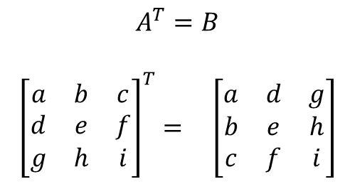
In-Class Exercise
Compute transpose of 2-dimensional list
E.g., A[0,2] = c, B[2,0] = c
For each i and j, B[j][i] = A[i][j]
$$A^{T}=B$$
$${\left[\begin{matrix}a & b & c \\ d & e & f \\ g & h & i\end{matrix}\right]}^{T}= \left[\begin{matrix}a & d & g \\ b & e & h \\ c & f & i\end{matrix}\right]$$
0
1
2
0
1
2
0
0
1
1
2
2

Slide 193
List Comprehension

Slide 194
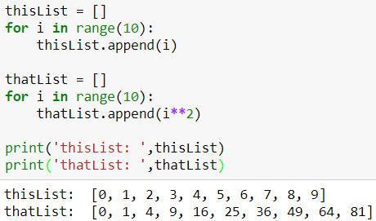
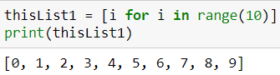
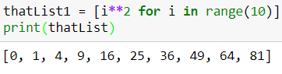
List Comprehension
We know what these programs do:
The shorthand for creating these lists are
See ListComprehension.ipynb

Slide 195
List Comprehension
Structure of basic list comprehension
[
]
Square brackets indicate that a list is being created
What to append
For Iterator

Slide 196
List Comprehension
Square brackets indicate that a list is being created
The value you want to append to the list based on the variable quantities you are iterating through.
An expression that causes a variable, i in this case, to iterate over many values. You can iterate through lists, dictionaries, tuples and other data structures.

Slide 197
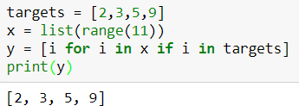
List Comprehension
if statements in list comprehension

Slide 198
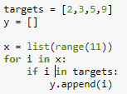
List Comprehension
Structure of list comprehension with if filter
[
]
What to append
For Iterator
Boolean Filtering Logic

Slide 199
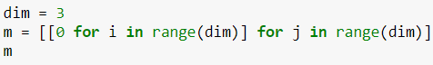
List Comprehension
2-dimensional list comprehension
Insert lists in a list

Slide 200
In-Class Exercise
Write a list comprehension statement that creates a list of even numbers from 0 through 16.
Write a list comprehension statement that iterates over the following list and only includes values if they are even
my_list = [5,11,12,34,51,62,8,18,19,20,21]
Do so with and without a lambda function
Revisit previous problem of creating list of elements from 0 to 15, except 2, 5, 7

Slide 201
Exercise Solutions
Create a list of even numbers
LCEven.py
Sort through a list and print a number only if it is even
LCSortEven.py

Slide 202
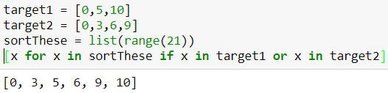
List Comprehension
More logic in list comprehension:

Slide 203
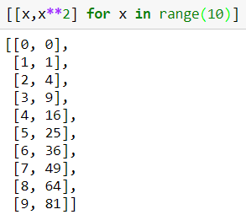
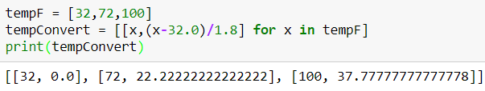
List Comprehension
Here’s a couple more examples:

Slide 204
In-Class Exercise
Write a list comprehension statement that filters a list of integers from 0 to 100, selecting only those which are multiples of 5, and includes the square of those integers in the new list.
Another way: create a list of the squares of integers which are evenly divided by 5.

Slide 205
Tuples Data Type

Slide 206
References
Textbook
Severance, Chapter 10

Slide 207
Tuples
x = (1,2)
y = ('blue','green')
z = ('red',255,0,0)
Tuples are like lists
Except they are immutable
Tuple elements values cannot be changed
Tuple elements cannot be deleted
Specified by parentheses
Elements separated by commas
Tuples can have any number of elements
Any data type, and mixed types
Iterable
Can use in loops

Slide 208
Tuples
Access tuple values using indices, as you do with lists
x = (0,1)
print(x[0])
y = ((0,1),(2,3))
print(y[0][1])

Slide 209
Tuples
Tuples can have any number of entries of any data types
E.g., a tuple with three elements is called a 3-tuple
(15,22,29)

Slide 210
Tuples
Let’s try these statements:
A tuple of tuples:
You cannot delete elements in tuples
y = ((0,1),(2,3))
del y[0]
del y[0][1]

Slide 211
Tuples
Let’s try these statements:
You can replace tuples with other tuples
y = ((0,1),(2,3))
y[0] = (4,5)
print(y)
y = ((0,1),(2,3))
y = (4,5)
print(y)

Slide 212
Tuples
Be careful! (a potential error)
1-tuples are possible but need a comma after the element
If you have a 1-tuple, then you must access the element’s value using an index as in the last statement
t1 = (0)
print(type(t1))
print(t1)
print(t1[0])
t2 = (0,)
print(type(t2))
print(t2)
print(t2[0])

Slide 213
Tuples
You can have tuples of lists:
Let’s try these statements:
What do you conclude from these computations?
z = ([0,1],[2,3])
z = ([0,1],[2,3])
print(z[0])
print(z[0][1])
del z[0]
del z[0][1]
del z[0][0]

Slide 214
Tuples
Slices work with tuples:
z[1:],z[:2],z[1:2]
Using sorted() with tuples
Sort by element in index 1 position
z = ((0,3),(2,2),(1,1))
print(z)
print(sorted(z))
z = ((0,3),(2,2),(1,1))
z = sorted(z, key = lambda x:x[1])
print(z)

Slide 215

Tuples
A unique feature in Python (see 10-1.py)
Multiple variables on left-side of statement
Python automatically makes the intuitive assignments, if one is possible

Slide 216
Data Types
It’s easy to make mistakes with data structures:
When you think you are using one data type but you are actually using another
E.g., numerical quantities versus tuples
Severance: “shape errors”
Gives you errors or, worse, doesn’t reveal itself as an error
Debug with the type() function to check

Slide 217


Data Types
Shape errors
“…errors caused when a data structure has the wrong, type, size, or composition.”

Slide 218
Data Types
Shape error examples

Slide 219
Data Types
When would you use lists?
When would you use tuples?

Slide 220
In-Class Exercise 1
2-tuples of integers represent the indices of Wal-Mart distribution centers that serve Wal-Mart stores
For example, (2,4) means that distribution center 2 supplies store 4
Indices are associated with locations
stores and dcs lists

Slide 221

In-Class Exercise 1
In Tuples.ipynb

Slide 222
In-Class Exercise 1
Write a program that:
Elicits an integer from a user using input(), which represents a distribution center
DC indices run from 0 to 5
Prints out a nice heading saying that this analysis is for a particular DC number located at a particular location
Prints out all store locations served by the DC whose index that was entered

Slide 223
In-Class Exercise 2
Read tuples.txt and transform into tuples

Slide 224
Dictionaries Data Type

Slide 225
References
Textbook
Severance, Chapter 9

Slide 226
Dictionaries
myDiction = {'zero':0,'one':1, 'two':2}
Dictionaries are sequences of key-value pairs
Specified by curly braces {put key-values here}
Like lists, but find values using keys, not indices
Colons separate keys and corresponding values
Commas separate key-value pairs
Values are mutable
Fast lookups
Try this
print(myDiction ['zero'])
myDiction ['zero'] = 99

Slide 227
Dictionaries
Get number of key-value pairs
Get keys (a property)
Result (order most likely differs from order of specification)
Get dictionary values:
myDiction.values()
len(myDiction)
print(myDiction.keys())
['zero', 'two', 'one']

Slide 228
Dictionaries
Can you think of a way to use key_list to print out all the key-value pairs in myDict in order of the keys?
myDiction = {'zero':0,'one':1, 'two':2}
keyList = list(myDiction.keys())
keyList.sort()
for thisKey in keyList:
print(thisKey,':',myDiction[thisKey])

Slide 229
Dictionaries
Looking for a key?
Use in and myDict.keys()
myDiction = {'zero':0,'one':1, 'two':2}
keyList = myDiction.keys()
print("Find key = 'zero':",'zero' in keyList)
myDiction = {'zero':0,'one':1, 'two':2}
words = ['uno','dos','tres','quatro','cero', 'zero', 'one', 'zwei']
for word in words:
if word in myDiction.keys():
print(str(word)+':'+str(myDiction[word]))

Slide 230
Dictionaries
Looking for a value?
Use in and myDict.values()
“\” is used here for line continuation
Typing a statement across multiple lines
myDict = {'zero':0,'one':1, 'two':2}
print("Find value = 0:", 0 in myDict.values())
print("Find value = 2:", 2 in myDict.values())
print("Find values = (0,2):", 2 in myDict.values() \
and 0 in myDict.values())
print("Find value = 3:", 3 in myDiction.values())

Slide 231
Dictionaries
A concise way to loop through:
What is happening in the first line vis-à-vis element and myDict?
What does element represent in successive iterations?
for element in myDiction:
print(element,':', myDiction[element])

Slide 232
Dictionaries
Another concise way to loop through:
for key,value in myDiction.items():
print(key,':',value)
for k,v in myDiction.items():
print(k,':',v)

Slide 233

Dictionaries
Iterating through Dictionaries

Slide 234
Dictionaries
Use a dictionary to create a histogram
Histogram: counts the frequency of occurrence for each value in a set of data
Assume that the data is in a list
For example, a histogram of this list,
[0,1,3,5,2,3,1,0,0,3,4,5]
is this:
0:3, 1:2, 2:1, 3:3, 4:1, 5:2
Value found in list
Number of occurrences for that value

Slide 235

Dictionaries
hist = {}
Curly braces on right create an empty dictionary
Strategy
Values in the list will be the keys
Dictionary values will be the counts of those keys
Try this in Dictionaries.ipynb.
What happens?

Slide 236

Dictionaries
If a key does not exist we need to create it

Slide 237

Dictionaries
It works. Can we do better?
More succinct?
Use dictionary hist.get() method
Creates a dictionary element if key is missing

Slide 238

Dictionary Comprehension
Similar to List Comprehension

Slide 239
Exercise
Starter code: DictionAssgnmt.py
Code these tasks:
Variable Name for Result | Data Type for Result | Task
names | List | Create a list of all student names.
sophNames | List | Create a list of all the first names of the students who are sophomores.
dictAvgGrade | Dictionary | Create a new dictionary with the same keys as in studentPerf and values that represent the average of each student’s four test grades.
dictDemClass | Dictionary | Create a dictionary, in which the keys are the class, 'sophomore', 'junior', and 'senior‘, and the values are the count of how many students fall into each class.
dictGradeClass | Dictionary | Create a dictionary with three elements. The keys for those elements are: 'sophomore', 'junior', and 'senior'. The values are to be the average grade of all students in the respective class.

Slide 240
File Input and Output

Slide 241
References
Textbook
Severance, Chapter 7

Slide 242
File I/O
Accessing files
f = open('file_with_path','r')
file_ref | Reference to file use in Python program. Use this later for reading & writing
file_with_path | String that describes path and file name. If path omitted, then Python will look in same folder as where program is stored
'r' | 'r' ‘ = read from file 'w' = write to file. If filename exists it is erased before writing commences 'a' = append 'r+' = reading and writing If omitted, 'r' is assumed

Slide 243
File I/O
Frequently used file functions
f.read()
Reads entire file
f.readlines()
Reads message in lines into list of string (str) data
for thisLine in f:
for-loop to iterate through the lines in the file
f.write()
Writes to a file
Parentheses must contain a single string
Use str() conversion and concatenation
f.close()
Always close the file after use to ensure output to file and conserve memory

Slide 244
File I/O
See FileIO.ipynb for file input and file output example

Slide 245
File I/O
Telling Python where to read and write
No folder path specification needed if file is in the same folder as the code being executed
Folder path for file is needed otherwise

Slide 246

File I/O
Get path with Windows File Explorer
Left-click on address bar
Ctrl+c to copy
Ctrl+v to paste in Python code

Slide 247
File I/O
Single backslashes, “\”, are interpreted as escape characters
For example, “\n” or “\r\n” means carriage return, newline
For our text encoding, usually “\n”
Replace backslashes with either:
Double backslashes (\\)
Forward slash (/)

Slide 248
In-Class Exercises
Input the data from tuples.txt
Take a look at the data first
Put all the data in each line in its own tuple
Create a list that contains all of the tuples
Print out the list of tuples
Write a file, named odds.txt, that contains all the odd integers less than 20
Notes:
7.4.py

Slide 249
The numpy Package

Slide 250
numpy
The numpy package (and pandas) are widely used
https://www.quora.com/What-are-the-best-Python-libraries-and-packages-for-data-science
Top Five Python Data Science packages
numpy
scipy
pandas
IPython (Jupyter)
matplotlib

Slide 251
numpy
Numerical analysis for Python
The numpy package is vast
This is just an introduction
numpy benefits include increased computation speed
Reference to numpy methods
https://docs.scipy.org/doc/numpy/reference/routines.html
We’ll use Jupyter to investigate numpy

Slide 252
numpy Methods Examples
Import numpy
import numpy as np
The np alias is typical
The basic numpy data type is an ndarray
x = np.array([3,2,1])
Like a list, but must contain data of only one type
numpy has it’s own sort method
x.sort()
In-place sort
In general, faster than the built-in Python method

Slide 253
numpy Methods Examples
Array (matrix, vector) creation
Matrix: A = np.array([[1,2,3],[4,5,6],[7,8,9]])
Vector: x = np.array([1,1,1])
x behaves like a column vector although it was entered in row vector form
Get array dimensions: A.shape, x.shape
Accessing numpy array elements
A[0,1] or A[0][1]
Array manipulation
np.transpose(A)

Slide 254
numpy Methods Examples
Array creation, again:
Create a matrix of zeros with 2 rows and 3 columns
np.zeros((2,3))
Create empty matrix with 3 rows and 5 columns
np.empty(shape=(3,5))
Create matrix with random values
np.random.rand(3,5)
Convert a vector into a diagonal matrix
np.diag([1,1,1])

Slide 255
numpy Methods Examples
Dot product
The dimensions must be appropriate
np.dot() takes 2 arguments
np.dot(A,x)
Nest .dot() to multiply 3 or more arrays
np.dot(np.dot(x,A),x)
Note the dimensions of the vector x are automatically made appropriate for dot product
2-dimensional arrays (matrices) are not adjusted
R = np.ones((2,3))
T = np.ones((2,3))
np.dot(R,T)
This will result in an error

Slide 256
numpy Methods Examples
Dot product
You can create a ‘matrix’ using np.matrix()rather than np.array()if your arrays are at most 2-dimensional
A_m = np.matrix([[1,2,3],[4,5,6],[7,8,9]])
x_m = np.matrix([1,1,1])
Accessing matrix elements
A_m[0,1]
A_m[0][1]doesn’t work like in numpy arrays
Vector dimensions will not be corrected when using np.dot(A_m,x_m)
Also use * for dot product with np.matrix():
A_m * x_m (doesn’t work)
A_m * np.transpose(x_m)

Slide 257
numpy Methods Examples
Some of numpy’s linear algebra capability is in a sub-package of numpy called linalg
2 ways to compute the inverse of a matrix:
import numpy as np
np.linalg.inv()
from numpy import linalg
np.linalg.inv()
Solve systems of linear equations
Solve Ax = b
np.linalg.solve(A,b)
A must be square and of full rank

Slide 258
numpy Exercise
Find a mix of cereals (number of grams each) that has 245 calories, 6 grams of protein, and 7 grams of fat
Nutritional info for cereals [calories,protein,fat]
Cheerios [120, 4, 2]
Cap’n Crunch [130, 3, 5]
Rice Crispies [105, 1, 2]
Solve Ax = b without using np.linalg.solve()
A = [[120,130,105],[4,3,1],[2,5,2]]
b = [245,6,7]
Check with np.linalg.solve()

Slide 259
numpy Methods Examples
Eigenvalues and Eigenvectors
np.linalg.eig()
Eigenvectors/values
λ is an eigenvalue of a matrix A and v its corresponding eigenvector if Av = λv
A matrix A meeting certain conditions, can be factored as A = QΛQ⁻¹
Λ is a diagonal matrix with eigenvalues on the diagonal
Columns of Q contain the eigenvectors

Slide 260
The pandas Package

Slide 261
pandas Package
The pandas package is vast
This is just an introduction
To learn more:
https://www.udemy.com/data-analysis-with-pandas/

Slide 262
pandas Package
Data manipulation and analysis
1, 2 and 3-dimensional data structures
Series, DataFrame, & Panels
File Input/Output
Data wrangling
Creating new columns of data
Converting data types
Handling null fields
Feature engineering, Filter & query, Database joins
Analysis
Histograms, descriptive statistics, math functions, sorting
Visualization

Slide 263
Pandas Series
Let’s use Jupyter to explore pandas
pandasIntroduction.ipynb
pandasDataFrames.ipynb
irisPandasStart.py
irisPandas.py
pd is a typical alias for pandas
import pandas as pd

Slide 264
Pandas Series
Series are 1-dimensional arrays
Series with categorical data:
ic = ['chocolate', …, 'vanilla']
ic = pd.Series(ic_list)
ic
dtype at bottom of listing shows data type of elements
type(ic)
ic.value_counts()
x = ic.values
type(x)
ic.index
ic.head(n=5)
ic.tail(n=3)

Slide 265
Pandas Series
Series Methods with numerical data
temp = [65.5, 37.8, … 69.7]
temp = pd.Series(temp)
temp
Notice dtype at bottom of listing for data type
type(temp)
temp.loc[1]
Get element with the index 1
Series have integer indexes by default
temp.iloc[1]
Get element in the 1st position

Slide 266
Pandas Series
Series Methods
temp.sum()
temp.mean()
temp.median()
temp.product()
temp.describe()
Type temp. and then type Tab to see all the alternative methods
Type temp.sort_values()
Hold Shift key, press Tab for all parameter choices
ascending = False
inplace = True
temp.sort_index()

Slide 267
Pandas Series
Series Methods
Appending Series
temp_new = pd.Series([0.0])
temp.append(temp_new)
print(temp)
Info on a Series
temp.size
temp.index
Dropping a Series element
temp.drop()

Slide 268

Pandas DataFrames
pandasDataFrames.ipynb

Slide 269
Pandas DataFrames
DataFrames are 2-dimensional arrays
Rows and columns
Columns have heading
Each column is of one data type

Slide 270
Pandas DataFrames
Import pandas
import pandas as pd
Read csv file
df = pd.read_csv('Iris.csv')
Get first few DataFrame rows
df.head()
Get first few rows of a particular column:
df['PetalLengthCm'].head()

Slide 271
Pandas DataFrames
Column headings
df.columns
df.columns.values
Get column
df.['put_col_heading_here']
Get row
df.loc[0] (by index label)
df.iloc[0] (by index number)
Get column
df['PetalLengthCm']

Slide 272
Pandas DataFrames
Get columns
df['PetalLengthCm', 'SepalLengthCm']
Get column data
df['PetalLengthCm'].values
Get column name
df['PetalLengthCm'].name
Get row and column
df['PetalLengthCm'].loc[0]
df['PetalLengthCm'].iloc[0]
df.loc[0]['PetalLengthCm']
df.iloc[0]['PetalLengthCm']

Slide 273
Pandas DataFrames
DataFrame shape
df.shape
type(df.shape)
Get column data types
df.dtypes
Get DataFrame data
df.values
Convert DataFrame data to list
df.values.tolist()

Slide 274
Pandas DataFrames
DataFrame descriptive statistics
df.describe()
Various individual statistics
df.mean()
df.median()
df.min()
df.max()

Slide 275
Pandas DataFrames
Properties applied to DataFrame columns
df['PetalLengthCm'].sum()
df['PetalLengthCm'].mean()
df['PetalLengthCm'].median()
df['PetalLengthCm'].shape
df['PetalLengthCm'].describe()
Get histogram data on categorical columns
df['Species'].value_counts()

Slide 276
Pandas DataFrames
Sort by column data
df.sort_values(by='SepalLengthCm',inplace=True)
df.sort_values(by=['PetalLengthCm'], inplace=True)
df.sort_values(by=['SepalLengthCm','SepalWidthCm'], inplace=True)
Sort by Index
df.sort_index(inplace=True)

Slide 277
Pandas DataFrames
Create new column
InPerCm = 2.54 # Conversion factor
df['PetalLengthIn'] = df['PetalLengthCm'] / InPerCm
Append rows to DataFrame
df.append()
Change column data type
df[column] = df[df[column].astype()
Drop rows with null fields
df.dropna(inplace=True)

Slide 278
Pandas DataFrames
Fill fields with nulls
df['Species'].fillna('NotSpecified',inplace=True)
Data on DataFrame
df.info()
Broadcast column
df.apply()

Slide 279
Formatting Numerical Values

Slide 280

Formatting Numerical Quantities
Formatting.ipynb

Slide 281

Formatting Numerical Quantities
Formatting.ipynb

Slide 282
Regular Expressions

Slide 283
Regular Expressions
Recognizing REGularly occurring character patterns (EXpressions)
Regex
Regex cheat sheets
http://regexr.com/
http://www.rexegg.com/regex-quickstart.html
https://www.cheatography.com/davechild/cheat-sheets/regular-expressions/

Slide 284
Regular Expressions
Purposes
Finding patterns of characters
For processing text, strings
Validating data entry:
Email addresses, phone numbers, social security numbers
Replacement, substitution
Cleaning text
Removing characters
Stripping whitespace characters, punctuation
Parsing text
Splitting strings into a list of words at occurrence of particular characters
Preliminary steps for text analysis

Slide 285
Regular Expressions
Examples
Search email message text and extract the email addresses associated with the text From
Strip carriage returns, \n, from text files
Search for characters with accents to detect foreign languages, e.g., ò
How?
Express the pattern in which you are interested using letters, numbers, and special characters
i.e., the Regex language

Slide 286
Regular Expressions
Regex examples (explore with regexr.com):
^: starts with some pattern
$: ends with some pattern
[]: match any of the characters in brackets
[a-z]: any lower case character
[a-zA-Z]: any letter
[0-9] or \d: any digit
.: any character, wildcard
\s: any whitespace character
\S: any non-whitespace character
Repetition of a (sub-)pattern
+: 1 or more; *: 0 or more; ?: 0 or 1
Use () to group conditions
|: Logical OR

Slide 287
Regular Expressions
Searching for From:
Exactly: From
Starts with F and ends with m with any number of letters between: F[A-Za-z]*m
Above, but permits upper of lower case F and m: [fF][A-Za-z]*[mM]
Above, but limits intermediate letters to 2: [fF][A-Za-z]{2}[mM]
Above, but limits intermediate letters to between 1 and 3: [fF][A-Za-z]{1,3}[mM]
Or, permit any number of any characters between: [fF].*[mM]

Slide 288
Regular Expressions Warm Up
Practice with regexr.com
Find numeric expressions
[0-9]+ or [0-9\.]+
Find consecutive sequences of characters
[A-Za-z]+
Find whitespace characters
\s
Find consecutive whitespace characters
\s+
Find all instances of s and t
s|t or [st]
Find all instances of ss and tt,
ss|tt
Find all instances of a period

Slide 289
In-Class Exercise
Write a Regex expression to find numbers in any of these formats
1234, 12.34, .1234, 1234.
… with any number of digits before and after a possible decimal point
Experiment, prototype with regexr.com

Slide 290

Regular Expressions
Python package
import re
Start with this code:
numericalFindTemplate.ipynb
See my solution: numericalFind.ipynb

Slide 291
Regular Expressions
Python Regex References
https://docs.python.org/2/library/re.html
https://docs.python.org/2/howto/regex.html

Slide 292
Regular Expressions
Frequently used methods
re.findall(regex, string2search)
Find this pattern: regex
In string2search
Return all instances of string2search in a list
re.find(regex,string2search)
Find the first, or first n instances
re.sub(regex,sub_text,string2search)
Substitute this text: sub_text
For this text: string2search

Slide 293
Regular Expressions
Frequently used methods
re.search('text_2_find','text_2_search')
Finds 'text_2_find'
Within the string 'text_2_search‘
If text_2_search is found then returns a re.match object
<_sre.SRE_Match at 0x3912b28>
Otherwise, returns a result of the NoneType

Slide 294

Regular Expressions
Investigate fromRegexrDotCom.txt
Do these tasks:
Find all consecutive strings of integers
Find words that start with wW
Find all Internet domains: xxx.xxx.xxx

Slide 295
Regular Expressions
Investigate fromRegexrDotCom.txt
One more task:
Substitute zz for each instance of ss

Slide 296

Regular Expressions
Solution: BootCampRegexSoln.ipynb

Slide 297
Regular Expressions
Regex Case Study 1: Detect email addresses

Slide 298
Regular Expressions
A more complex example…
Mimic how regex development might proceed
Find email addresses in Hillary Clinton’s email
With whom did she correspond?
Email addresses have this symbol: @
Use regexr.com for prototyping
11-0.py looks for “at sign” @ … a bit silly
Use regexr.com to develop the code for letters before and after

Slide 299

Regular Expressions
Find email addresses (11-2.py)
Change the file path for your computer
‘\S+@\S+’
\S matches any non-whitespace character
+ looks for any number of those characters
@ matches @
Translated
Any series of characters before the @, and any series of characters after
Pattern is interrupted on either end by whitespace

Slide 300

Regular Expressions
How long did this take?
Use the time package to find out
import time

Slide 301

Regular Expressions
Still some housekeeping to do…
Get rid of (most) extraneous characters at beginning and end of extracted addresses
E.g., [, ], <, >
'[a-zA-Z0-9]\S*@\S*[a-zA-Z]'
A single letter or number
Followed by zero or more non-whitespaces
Followed by @
Followed by zero or more non-whitespaces
Followed by a letter

Slide 302

Regular Expressions

Slide 303

Regular Expressions
Still some housekeeping to do…
Check output for further required filtering
Use re.sub()to delete unwanted characters

Slide 304
Regular Expressions
Study email address specifications:
https://en.wikipedia.org/wiki/Email_address
Further possible refinements:
One or more repetitions of letters/numbers and a dot after the @ followed by 2 to 5 letters
Letters/numbers and other allowable characters before the ampersand
Discussion
Escape character, \
If you mean a period, then use \.
If you mean a backslash then \\

Slide 305
Regular Expressions
Regex to detect email addresses
http://regexlib.com/Search.aspx?k=email&AspxAutoDetectCookieSupport=1
([a-zA-Z0-9_\-\.]+)@([a-zA-Z0-9_\-\.]+)\.([a-zA-Z]{2,5})
http://stackoverflow.com/questions/46155/validate-email-address-in-javascript
(([^<>()\[\]\.,;:\s@\"]+(\.[^<>()\[\]\.,;:\s@\"]+)*)|(\".+\"))@(([^<>()[\]\.,;:\s@\"]+\.)+[^<>()[\]\.,;:\s@\"]{2,})
http://emailregex.com/

Slide 306
In-Class Exercise
Write Regex for detecting phone numbers with area code, which would flag these types of patterns:
617.555.1212
467-927-5823
Extra credit; detect these also:
(517) 321-2725
(800)-555-1212

Slide 307

Exercise
Possible solution

Slide 308
Regular Expressions
Regex Case Study 2: Create histogram of word usage
How many times is each word used?
A dictionary is useful
This is one of the basic skills in text mining, natural language processing, unstructured data (of the textual nature), or whatever you want to call it

Slide 309
Case 2 Steps
Input text
Convert text to lower case
‘She’ and ‘she’ should be combined in the same histogram bin
Remove punctuation
re.sub(), str.replace()
Split text into words
str.split()
remove whitespace from right and left
str.strip()
Make histogram w/dictionary .get statement

Slide 310
Regular Expressions
Other functions for stripping characters:
rstrip() strip all whitespace from right side
lstrip() strip all whitespace from left side
You can strip other character patterns from string variables by inserting arguments in lstrip(),rstrip(), and strip()

Slide 311
Machine Precision

Slide 312
Machine Precision
Computers (most often) do not represent numerical values exactly because
Computers represent numbers in binary format
Base 2, 0s and 1s
Computers store limited decimal places
Base 10
1000 | 100 | 10 | 1 |  | 1/10 | 1/100 | 1/1000 | 1/10000 | 1/100000 | 1/1000000
 |  |  |  | .
Base 2 (binary)
8 | 4 | 2 | 1 |  | 1/2 | 1/4 | 1/8 | 1/16 | 1/32 | 1/64
1 | 0 | 1 | 1 | . | 0 | 1 | 0 | 0 | 0 | 0

Slide 313
Machine Precision
Enter a number that cannot be expressed exactly in binary, for example
x = 0.1
print("{:10.20f}".format(x))
or
print('% 6.20f' % x)
Here % means replacement rather than modulus
0.1 ≅ 0.099854
 | 1/2 | 1/4 | 1/8 | 1/16 | 1/32 | 1/64 | 1/128 | 1/256 | 1/512 | 1/1024
. | 0 | 0 | 0 | 1 | 1 | 0 | 0 | 1 | 1 | 0

Slide 314

Machine Precision
We can test the limits of our computer’s precision capabilities
What is the smallest number that we can add to one that is “recognized” by the computer?

